Slide 1
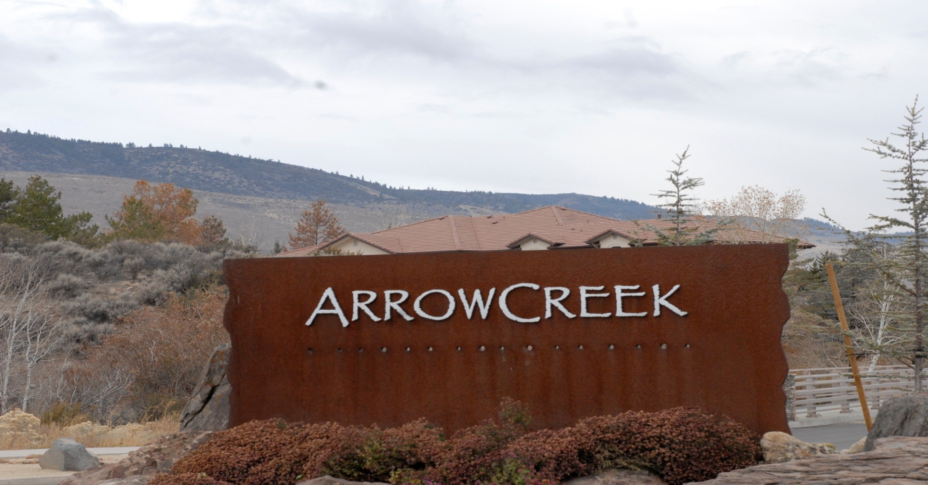
Should the HOA Invest in a Golf Course

Slide 2
Content
1. Why would you want to buy a golf course?
2. Has the HOA Board become partisan?
3. Friends of ArrowCreek or Fund Our Activities?
4. What are our options?
Visit Our web-site:
www.arrowcreek411.workpress.com

Slide 3

Golf Course Industry

Slide 4
Golf Industry in the US
Becoming Less Profitable
One-third of golf courses nationally are operating at a loss.
The cost of maintaining an 18-hole golf course has nearly doubled in the last 7 years.
Sources: http:// hospitalitynet.org/news/4063485.html (Ex 3A)
http://www.bloomberg.com/news/2014-05-23/golf-market-stuck-in-bunker-as-thousands-leave -the sport.html

Slide 5
Golf Industry in the US
The sport is suffering from an exodus of male players, a lack of interest among millennials and the mass closure of courses.
-650,000 men quit playing
+260,000 women starting playing
-390,000 players left the game

Slide 6
Golf Industry in the US
Golfers per course have decreased every year since 2007.
665 golf courses have closed in the country in the past 5 years.
200,000 players under the age of 35 abandoning the game last year

Slide 7
Golf Industry in the US
Golf in the US peaked in 2007 at 29,500,000 golfers, in 2012 the number contracted to just 14,400,000 or a -51.1% drop in five years.
Source: www.hvsgolf.com (Ex.3C)

Slide 8

Golf in ArrowCreek

Slide 9
Golf in ArrowCreek
If your contract states that your community “owns the golf course,” or that membership is “mandatory,” your home is collateral for all of the debts generated by the golf course.

Slide 10
Golf in ArrowCreek
ArrowCreek homeowners must realize that if the courses are acquired by the HOA, our liabilities do not end with additional fees required to subsidize the golf course. Our homes will become collateral for any unpaid debts.

Slide 11
Golf in ArrowCreek
Through inevitable increases in dues and special assessments each member becomes personally liable for:
  future expenses,
  operating costs,
  maintenance costs,
  interest on loans,
  insurance premiums,
  reserves and capital expenditures.

Slide 12
Golf in ArrowCreek
Before you enter into a horrendously expensive, speculative investment like this, provide your accountant, or investment advisor with these facts:
The ArrowCreek Community Club Committee’s Report distributed at the August 26, 2014 HOA meeting.
The Recommendations for Dealing with the Aspen Sierra Bankruptcy and Update on Community Proposal, presented at he Board Meeting on
November 4, 2014.

Slide 13
Why buy a golf course?

Slide 14
Why buy a golf course?
“Because it’s a good investment.”

Slide 15
Why buy a golf course?
“To Protect Our
Property Values”

Slide 16
Why buy a golf course?
“To Prevent the Course from Going Brown”

Slide 17
Why buy a golf course?
“To Bring the Community Together”

Slide 18
Why buy a golf course?
“To Control Our Destiny So Developers Won’t Build a
Mini-mall”

Slide 19
Why buy a golf course?
“The Cost is a Bargain. We’ll never see the price of land so low again! ”

Slide 20
Why buy a golf course?
“I like the idea of playing golf and dining inside ArrowCreek”

Slide 21
HOA Board
Partisan

Slide 22

HOA PARTISAN BOARD

Slide 23
Definition of Partisan
Person who shows biased, emotional allegiance.

Slide 24
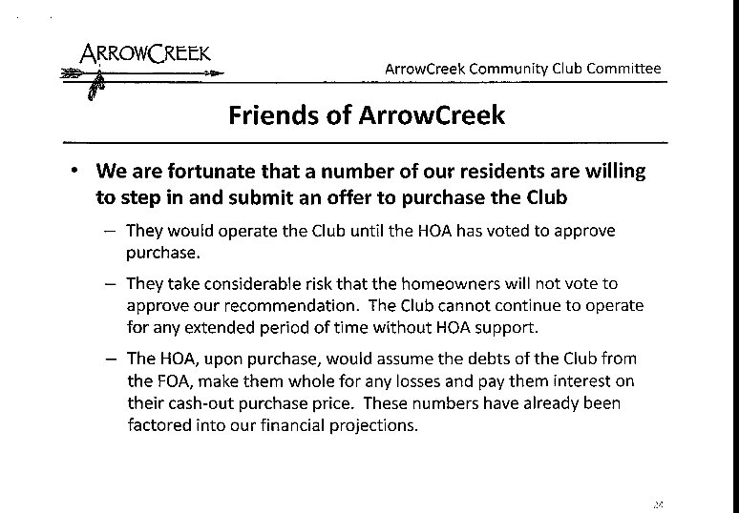

Slide 25
HOA Focus
It is not in the charter of the HOA to buy and create a joint venture with a golf course!

Slide 26
ArrowCreek Homeowners Update
Due Diligence December 2014 Page-3
During the loan process, a solid purchase price number from FOA will be developed to determine the size of the loan.
The impact of the loan on monthly ACHOA member’s assessments will be completed.

Slide 27
ArrowCreek Homeowners Update
Due Diligence December 2014 Page-3
Draft loan terms, interest rates, collateral pledges, loan limitations, etc. for the purchase of the “Club at ArrowCreek” are being explored.

Slide 28
ArrowCreek Homeowners Update
Due Diligence December 2014 Page-4
A draft ACHOA budget is being developed to determine the impact to the aggregate monthly assessment for ACHOA members.

Slide 29
You need to know the facts?

Slide 30
Declaration of Sam Fox in Support of ArrowCreek HOA in Support of FOA
“The joint venture would be funded in part by increased monthly dues ($75-$80 per month) from HOA members.
All residents would thereby become social members of the Country Club.”
E-filed September 9, 2014 Page Two

Slide 31
HOA August 26, 2014 meeting
Three potential alternatives were presented:
1.”Let it go brown”
2. “Keep it green”
3. “Operate as a golf course, meaning to find an appropriate arrangement so the Club would continue to operate on a stable, viable basis.”

Slide 32
HOA August 26, 2014 meeting
Was there a Fourth Option?

Slide 33
HOA August 26, 2014 meeting
The Board asserted that “Do Nothing was discussed but dismissed due to lack of control over land use and the threat posed by unmitigated fire risk.”
The statement that “Do nothing” was not an alternative for the HOA was false!

Slide 34
HOA August 26, 2014 meeting
The Committee and Board members knew that the FOA had a 5-page plan and would be purchasing the courses and operating them with Arnold Palmer Management based on documents filed with the bankruptcy court.

Slide 35
HOA August 26, 2014 meeting
They knew in mid-August the FOA had told the Bankruptcy Court that the FOA had the funding for the purchase of the golf courses, and that when acquired, the golf courses would continue and in fact be expanded.

Slide 36
HOA August 26, 2014 meeting
Our Board knew the FOA was going to purchase the golf courses and continue to operate them indefinitely.

Slide 37
HOA August 26, 2014 meeting
The FOA’s plan should have been disclosed to the homeowners at the Board meeting of August 26th , so our homeowners would know that, indeed, there was a fourth choice:
“Do Nothing.”
And “Do Nothing” should be our choice, to let the FOA own, operate and maintain the courses.

Slide 38
HOA August 26, 2014 meeting
The board was well aware by mid-August that:
the HOA was not required to purchase the course out of bankruptcy,
there were two bidders to purchase the courses.

Slide 39
HOA August 26, 2014 meeting
The Board permitted this deceptive presentation on August 26th and then on September 9th filed pleadings with the Bankruptcy Court supporting the FOA’s purchase over the other bidder.

Slide 40
ArrowCreek Homeowners Brief in Support of FOA and a declaration by
HOA President Sam Fox
Mr. Fox states in his declaration that:
HOA’s Board voted to support FOA and it has requested that the general membership vote to support FOA’s acquisition.
HOA supports the FOA as the successful bidder for the country club
FOA’s business plan has a strong long-term financial outlook;
FOA has worked closely with the HOA committees to obtain mutual benefit and develop a sound financial plan;
FOA is comprised primarily of ArrowCreek residents who have a strong interest in revitalizing the golf club, by not only offering golf related activities, but also social activities in its facility, thereby improving quality of life for all of the residents.

Slide 41
HOA Board Partisan Summary
For the HOA Board to withhold information from the homeowners, and then make misrepresentations of facts, would appear to be a breach of their fiduciary duties.

Slide 42
FOA: is it
Friends of
Arrowcreek or
Fund Our Activities?

Slide 43
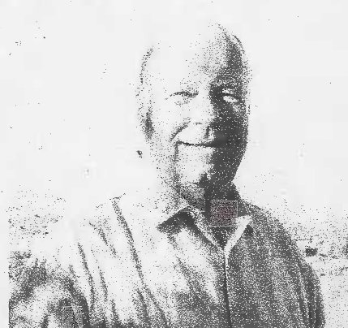
FOA

Slide 44
Friends of ArrowCreek
The courses at ArrowCreek have lost money EVERY YEAR.
The Friends of Arrowcreek willingly bought the golf club, we all wish them well with their investment.

Slide 45
Friends of Arrowcreek
As FOA’s President told the Reno Gazette Journal, If our HOA didn’t purchase the golf courses, “Our goal was never to make a profit and sell it, he said. If Arrowcreek homeowners chose not to control their own destiny, then we are prepared to keep both courses, and sometime down the road, when it’s profitable, we could sell it.”

Slide 46
Friends of ArrowCreek
In the four communities, APG/HOA partnerships, the residents are all required to pay mandatory social dues to the club.
At Prescott Lakes in Prescott, Arizona the additional fee was $120.00 per homeowner for no additional benefit.

Slide 47
FOA OPEN LETTER
December - 2014
“However, if the HOA does not purchase the club then we must act to protect the interests of our investors which could result in sale of the club to outside investors, partial closure of the golf courses or other alternatives.”
Gary W. Pestello & Tom Gurney
Managing members of the FOA

Slide 48
FOA Summary
What is the FOA real message?
Golf course to be run indefinitely?
Golf course to be sold?

Slide 49

How about some options?

Slide 50
What Options Do We Have?
Seven Proposed Options

Slide 51
Option 1.
The FOA owns the club, let them build it into a profitable business without any subsidy from the HOA homeowners.

Slide 52
Option 2.
One home owner suggested that we put a dollar amount on the venture say $50.00 per lot owner per month for 24 months, if the club is not profitable then we stop the subsidy.

Slide 53
Options 3.
Another home owner recommended that the HOA Board, FOA and a group of owners sit down and hammer out an agreement to make Arrowcreek more community focused.
End the divide.

Slide 54
Option 4.
The HOA buys the land and club from the FOA, and forms a JV with AP-Golf.
Be prepared to never vote on this
again because, after your first and
only vote, the HOA Board has all
the power to increase future
dues without your vote.

Slide 55
Option 5.
HOA buys the Club, imposes a cap of $3,000 dollars over 2 years as approved by a super majority (67%)
of lot owners.

Slide 56
Options 6.
Enter into an agreement with FOA that will give all 1,086 lot owners full use of the golf course for three rounds of golf a month for $100.00 dollars per month, or $1,303,200 dollars annually.

Slide 57
Options 7.
Petition the HOA Board to cease ALL activities related to the purchase of the Club at ArrowCreek.

Slide 58

Summary

Slide 59
Should the HOA Invest in Golf Courses?
1. Why would you want to buy a golf course?
2. Has the HOA become partisan?
3. Friends of ArrowCreek or Fund Our Activities?
4. What are our options?

Slide 60
Other Options from the Audience
We will include recommendations from each session to expand our options and give that feedback on the community website.
www.arrowcreek411.wordpress.com

Slide 62
Should the HOA Invest in a Golf Course
Golf industry in long-term decline
HOA Board
FOA Investment
Options

Slide 63
What Options Do We Have?
Currently the HOA and lot owners have no Loan to anybody. If the JV goes through we would have a new loan, how big and at what interest rate nobody knows as of today.

Slide 64
What Options Do We Have?
Currently the HOA and lot owners have no collateral pledges to anybody if the JV goes through we would have collateral pledges, how big nobody knows as of today.

Slide 65
What Options Do We Have?
Currently each lot owner pays HOA dues of $218.00 a month or $2,616.00 annually.
We have no answers to the annual dues or their rate of increase as of today.

Slide 66
What Options Do We Have?
We know the process of picking an option that 1,086 lot owners agree upon is impossible.
Your only job is to garner as much fully unfiltered information as possible and then to vote based on your personal needs and wants.

Slide 68
Friends of Arrowcreek versus our HOA
The big 800 pound gorilla question in the room is this:
Who can do a better job at building community activities for all 1,086 lot owners… our own HOA or APG?

Slide 69
We Can Do Better

Slide 70
We Can Do Better
NO Million dollar a year Subsidy!
If we want to spend a million dollars a year let’s invest in our community not in a subsidy that returns less to all 1,086 lot owners but to building our community.

Slide 71
We Can Do Better
Let’s get a clear picture on home values with and without a golf course. Let’s visit D’Andrea, Arrowcreek and Montreux .

Slide 72
We Can Do Better
The argument about property values going down if the golf course closes doesn’t really paint the proper picture.
Between 2008 and 2011, property values declined in Arrowcreek with the golf courses. Values have increased the last few years with the golf course in bankruptcy.

Slide 73
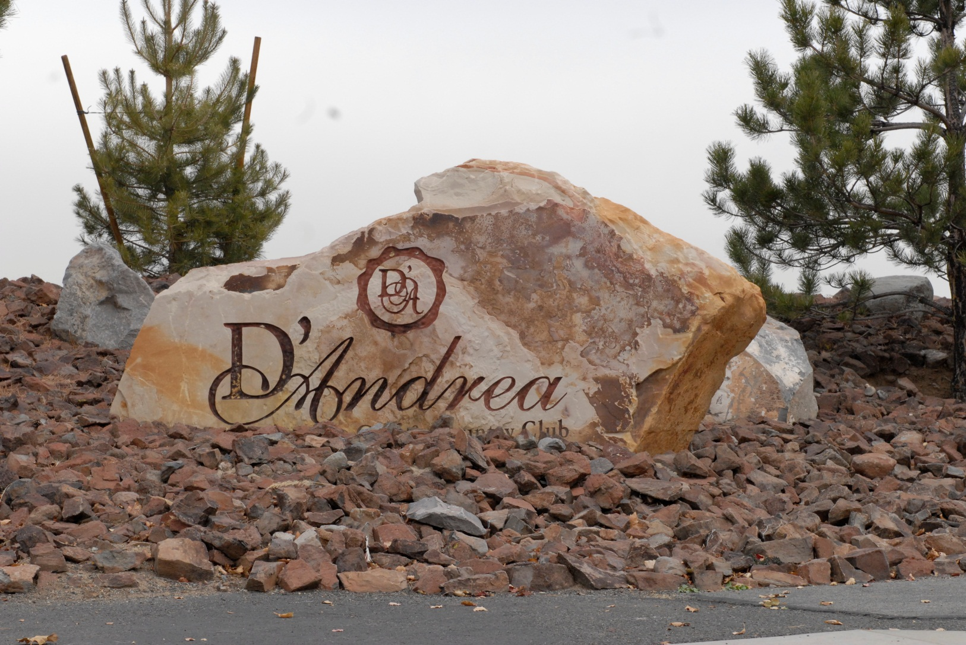
D’Andrea

Slide 74
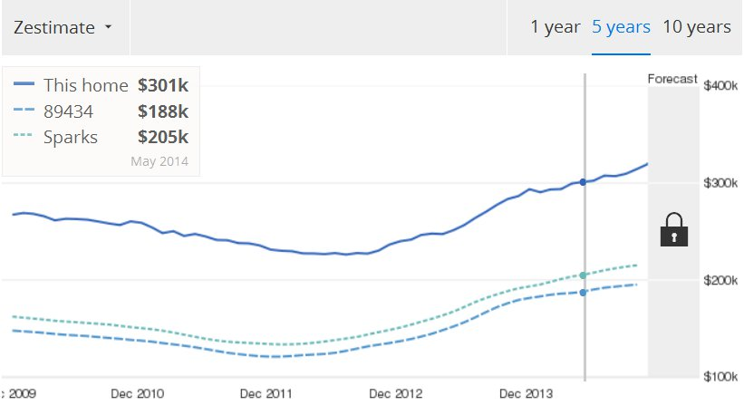
D’Andrea
2475 Sorrento Court

Slide 75
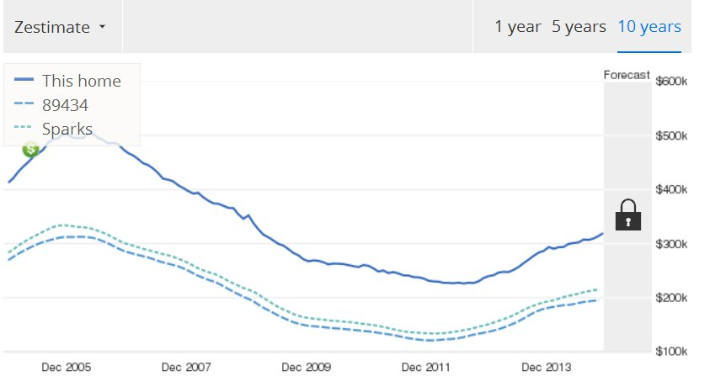
D’Andrea
2475 Sorrento Court

Slide 76

Arrowcreek

Slide 77
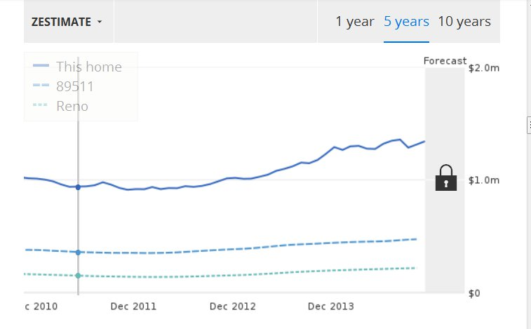
Arrowcreek
5720 Indigo Run Drive

Slide 78
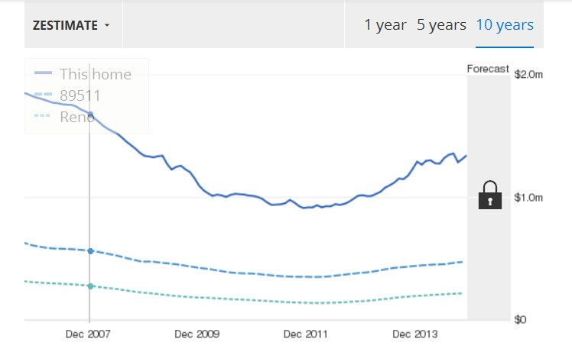
Arrowcreek
5722 Indigo Run Drive

Slide 79
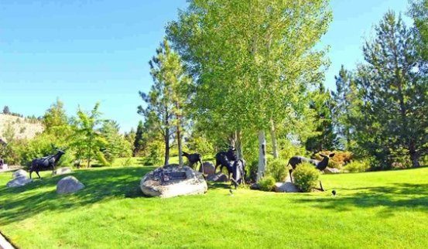
Montreux

Slide 80
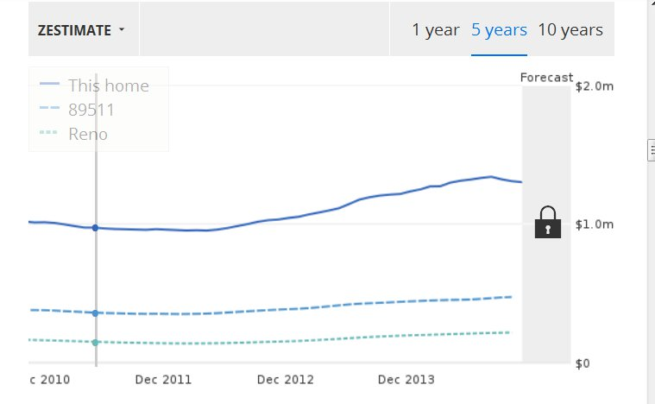
Montreux
5720 Dijon Circle

Slide 81
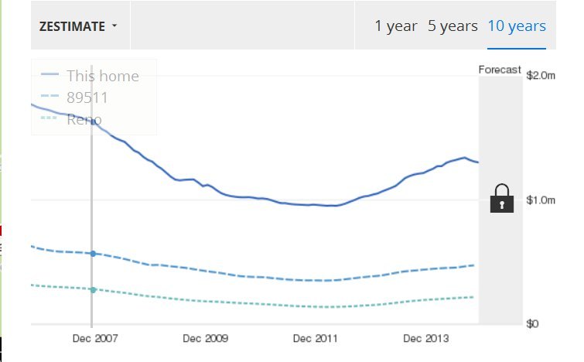
Montreux
5720 Dijon Circle

Slide 82
D’Andrea

Slide 83
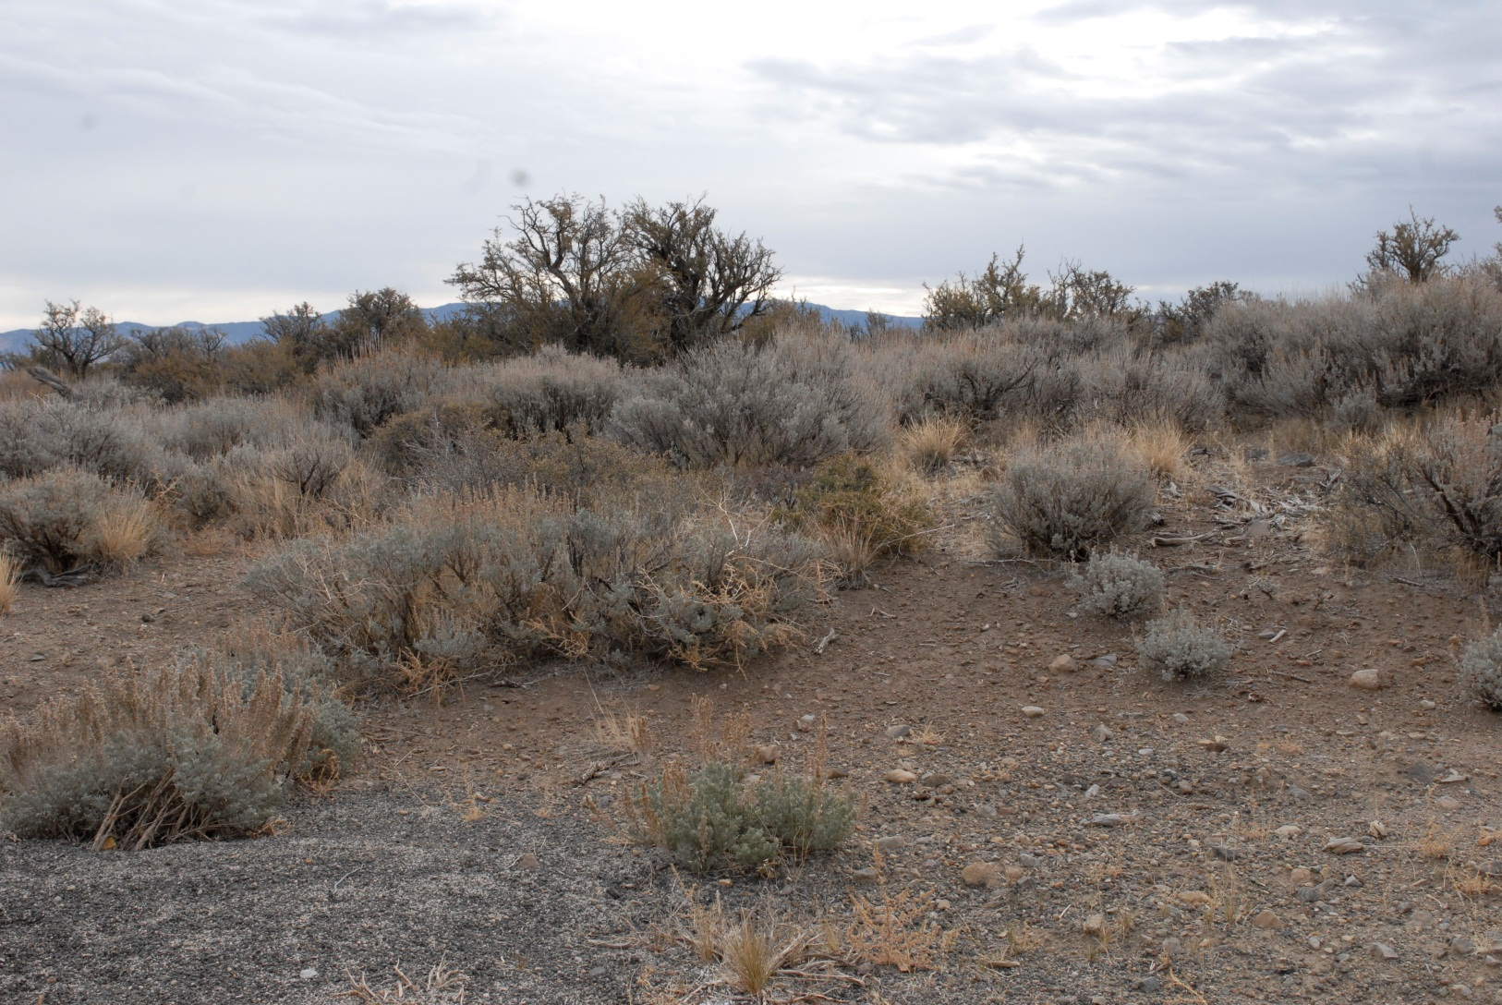
D’ Andrea

Slide 84
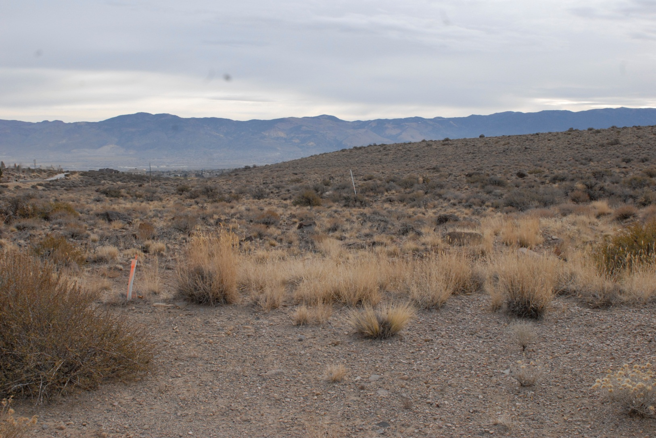
D’Andrea

Slide 85
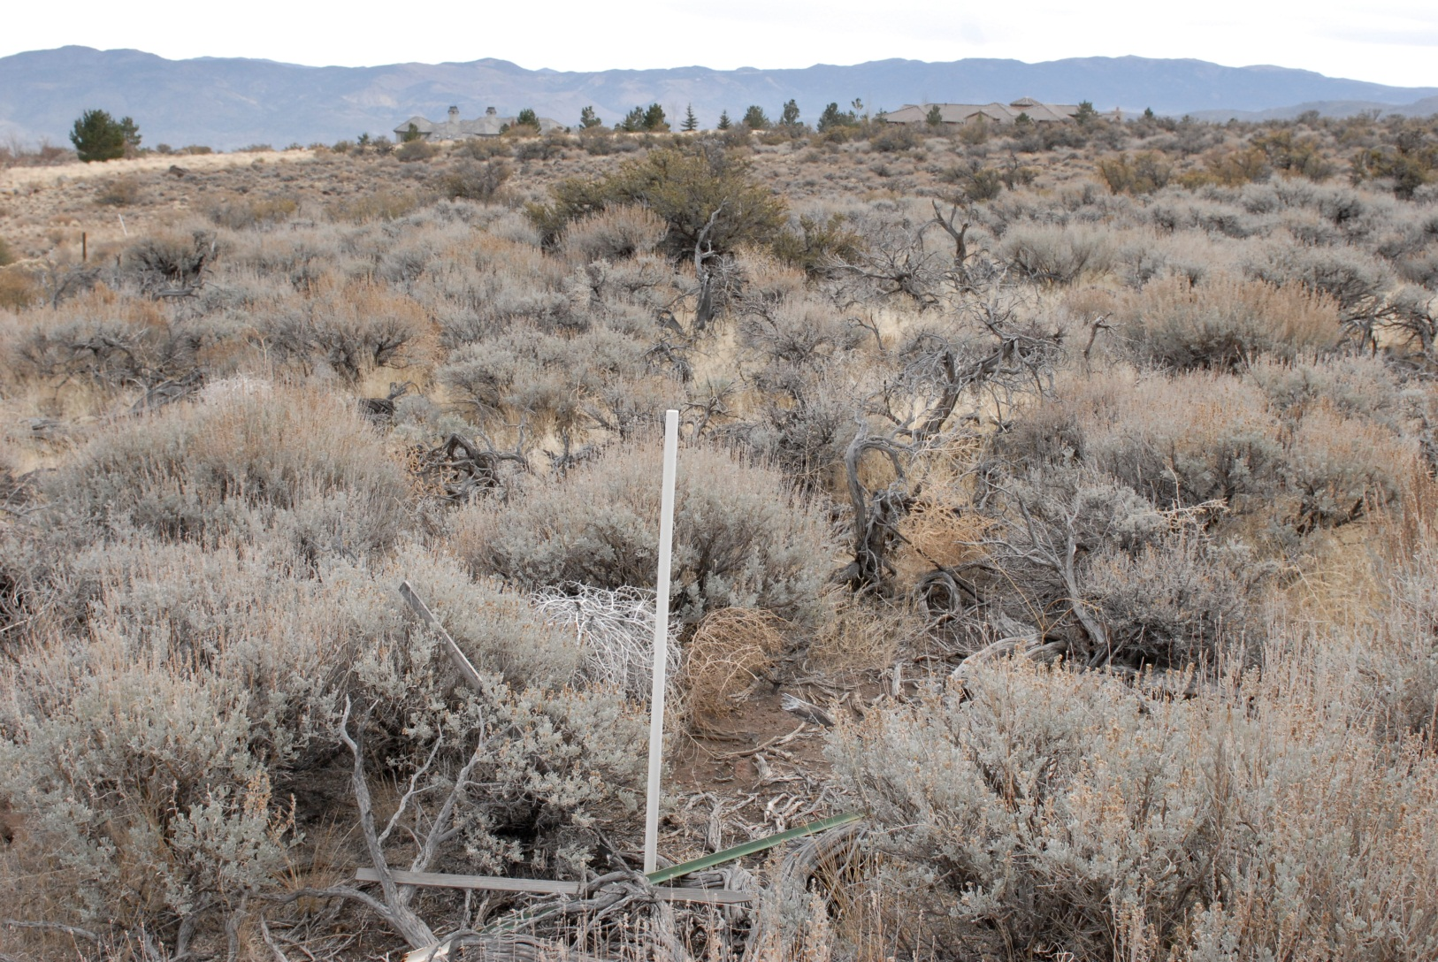
D’Andrea

Slide 86
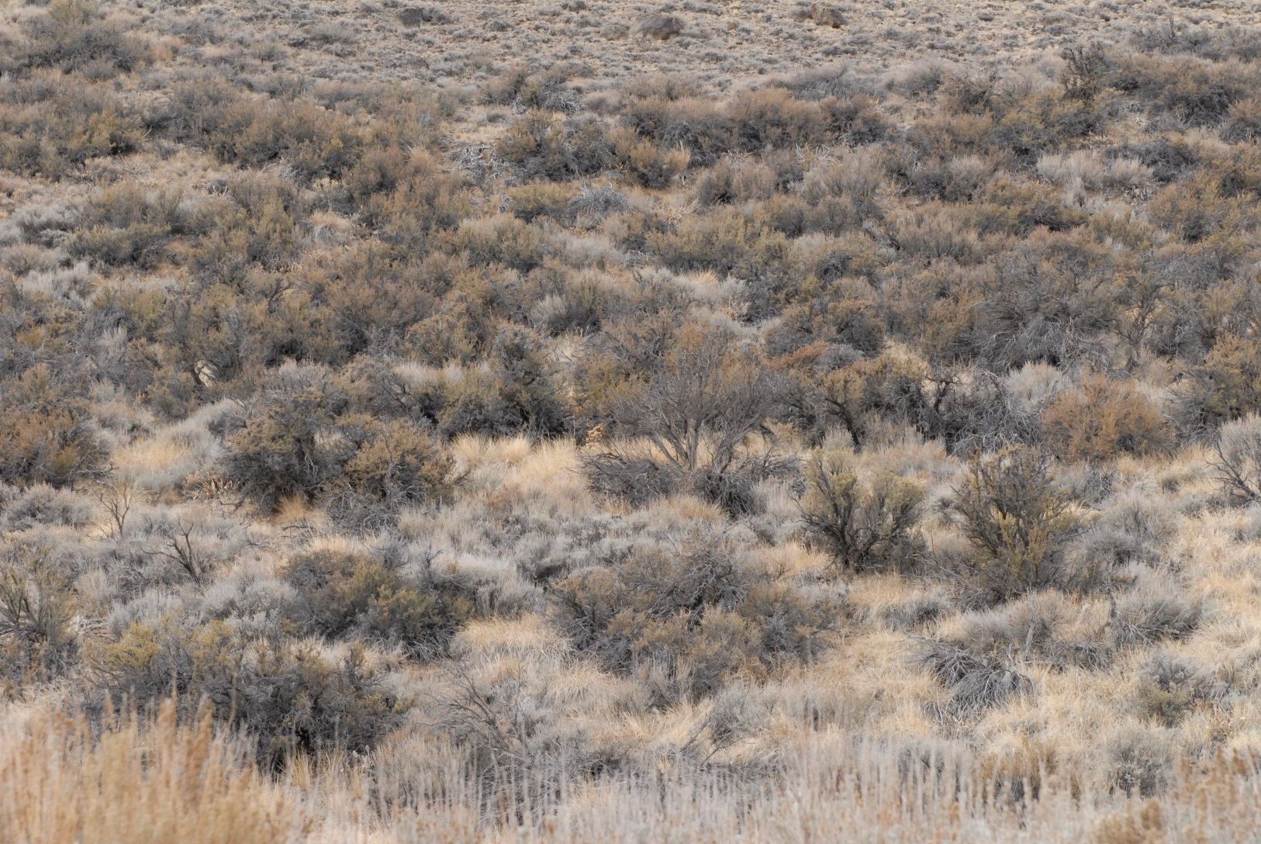
D’Andrea

Slide 87
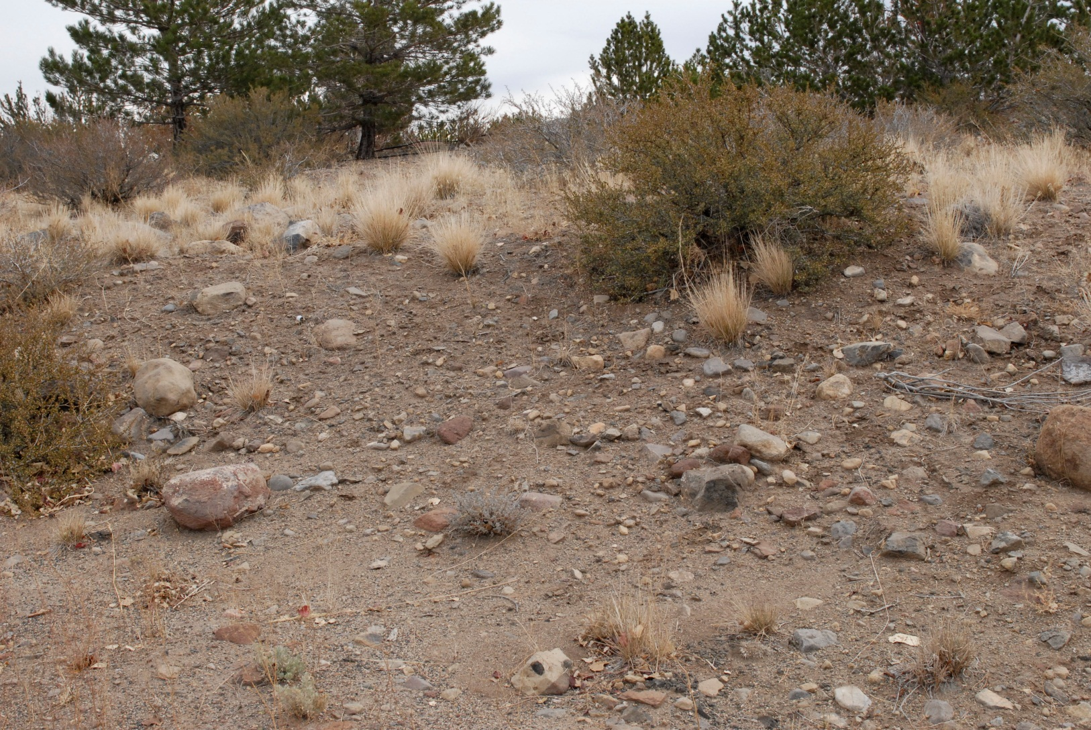
D’Andrea

Slide 88
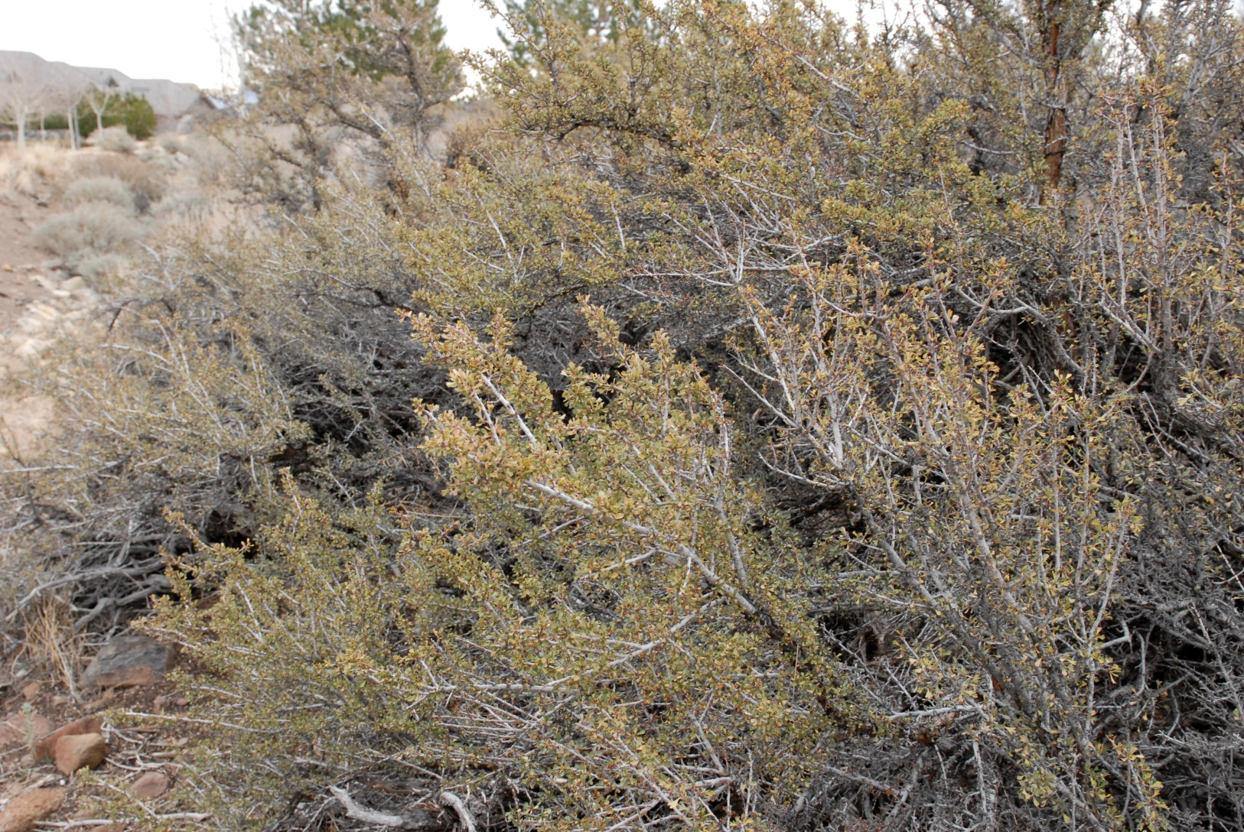
D’Andrea

Slide 89
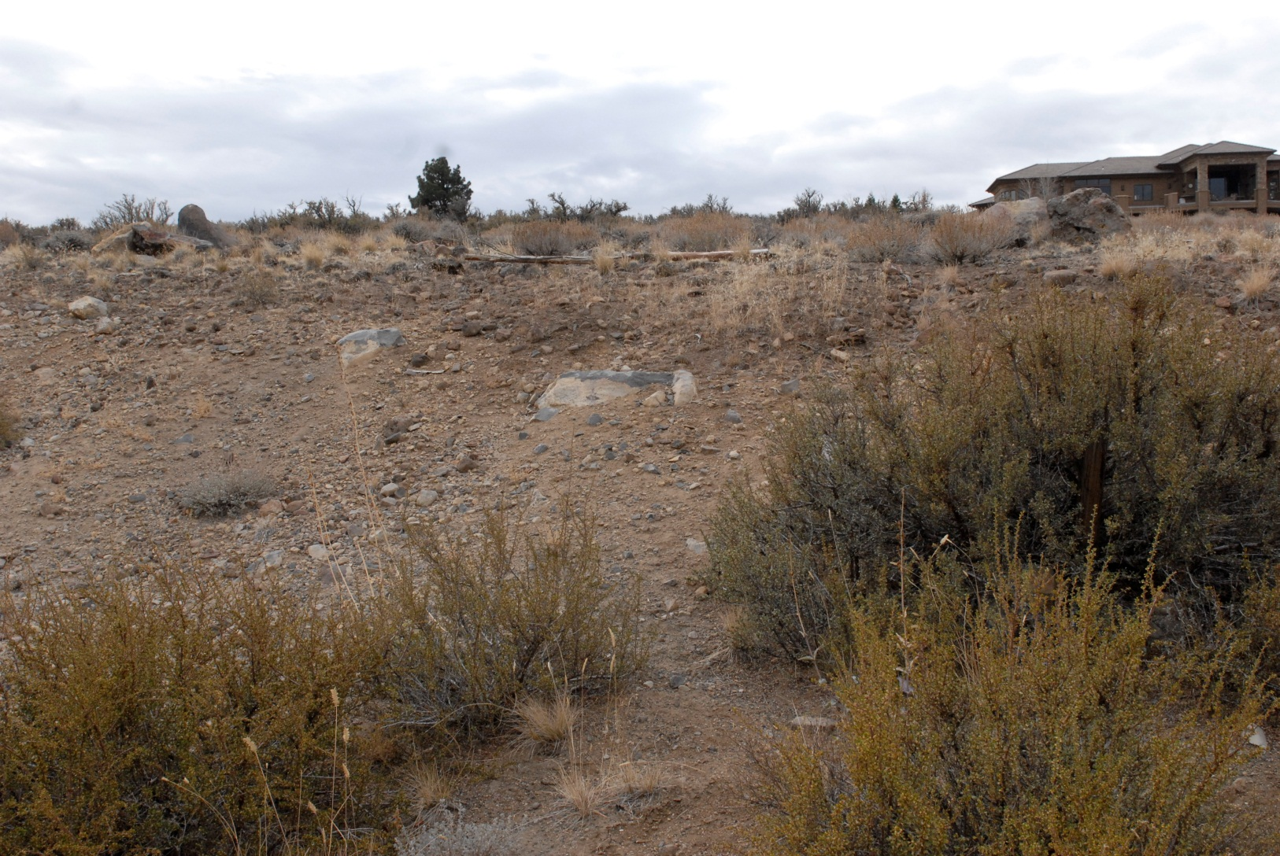
D’Andrea

Slide 90
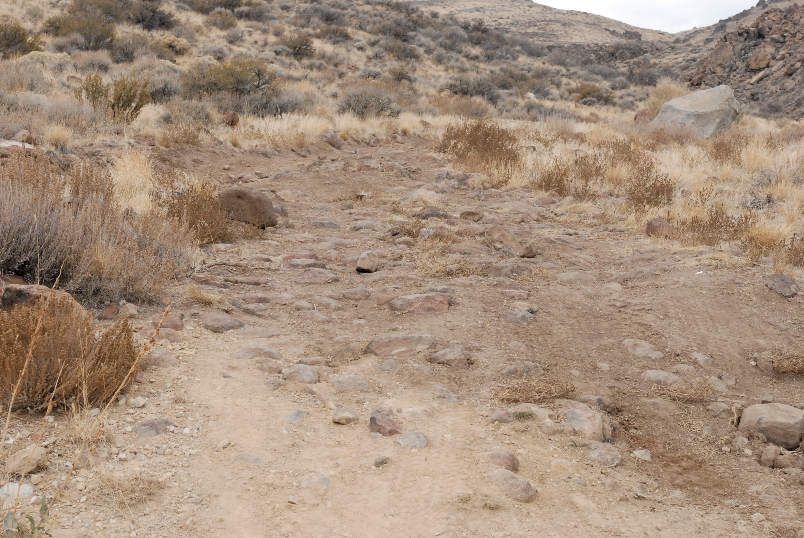
D’Andrea

Slide 91
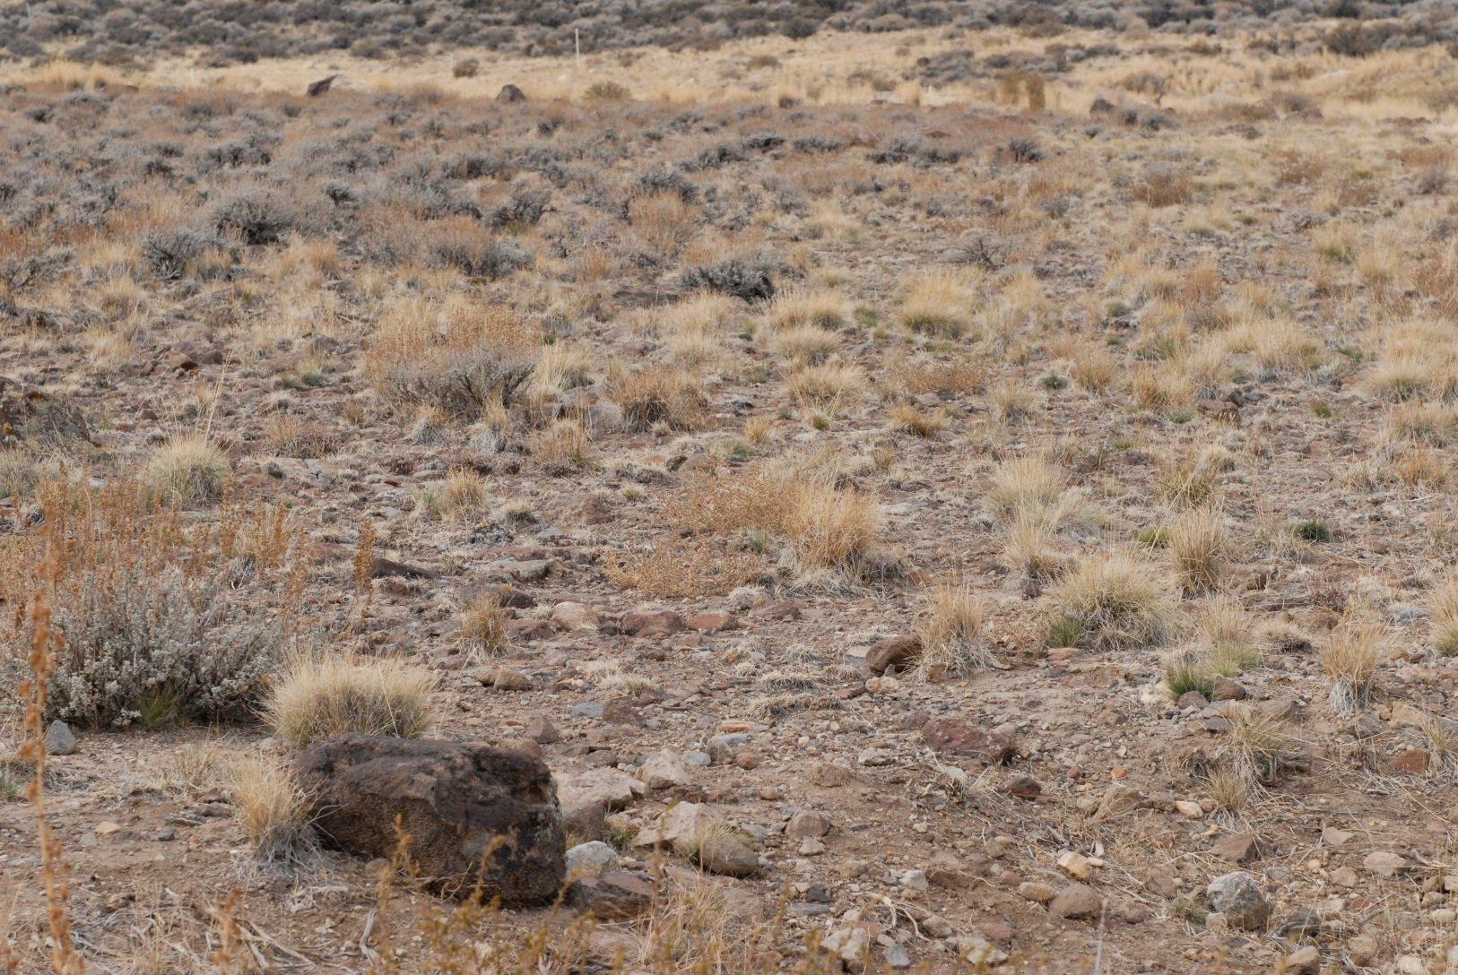
D’Andrea

Slide 92
Arrowcreek

Slide 93
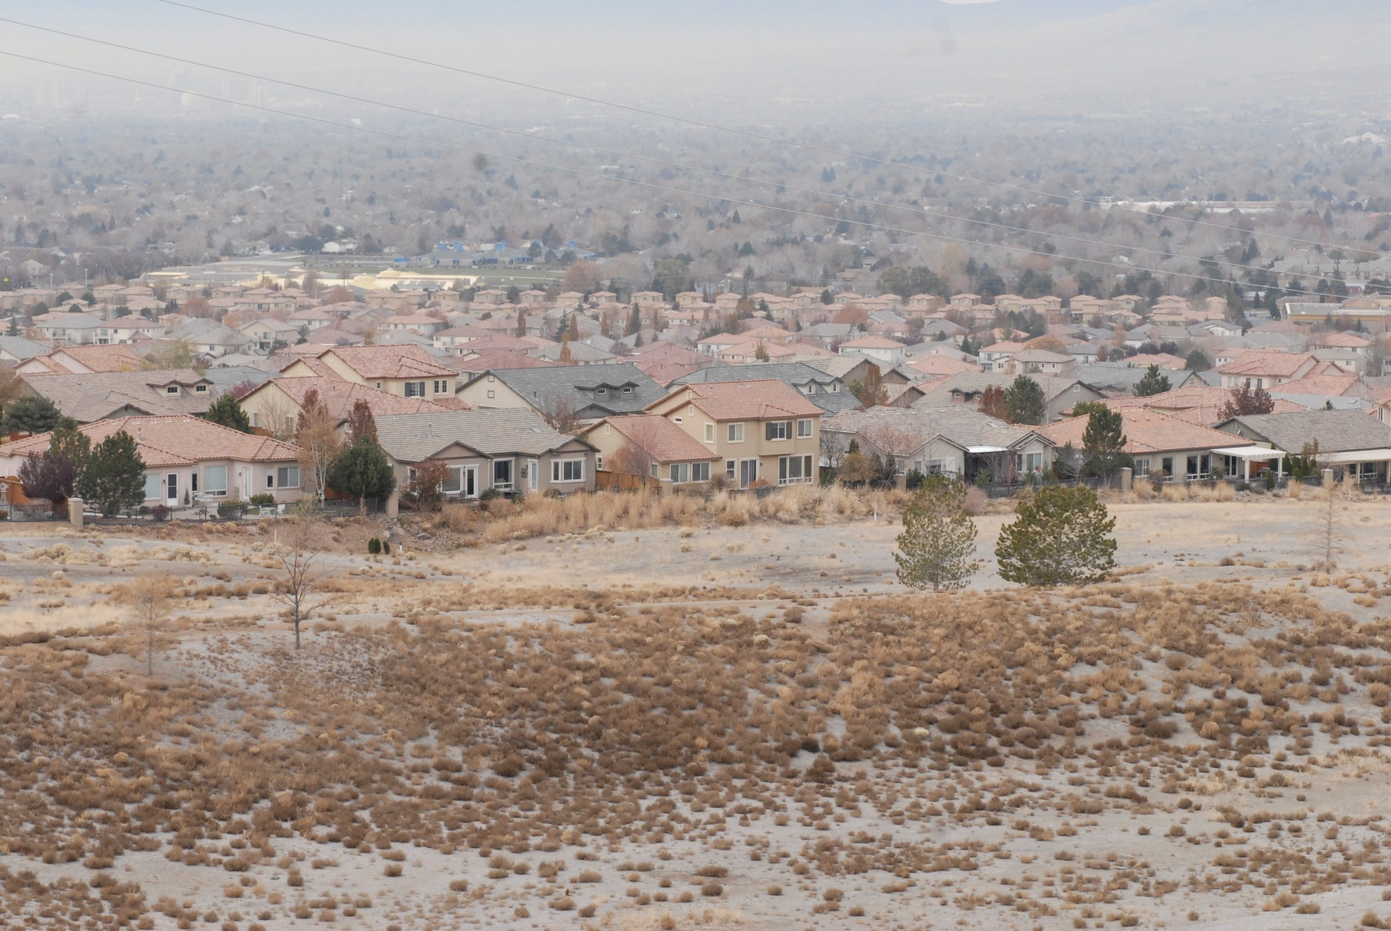
Arrowcreek

Slide 94
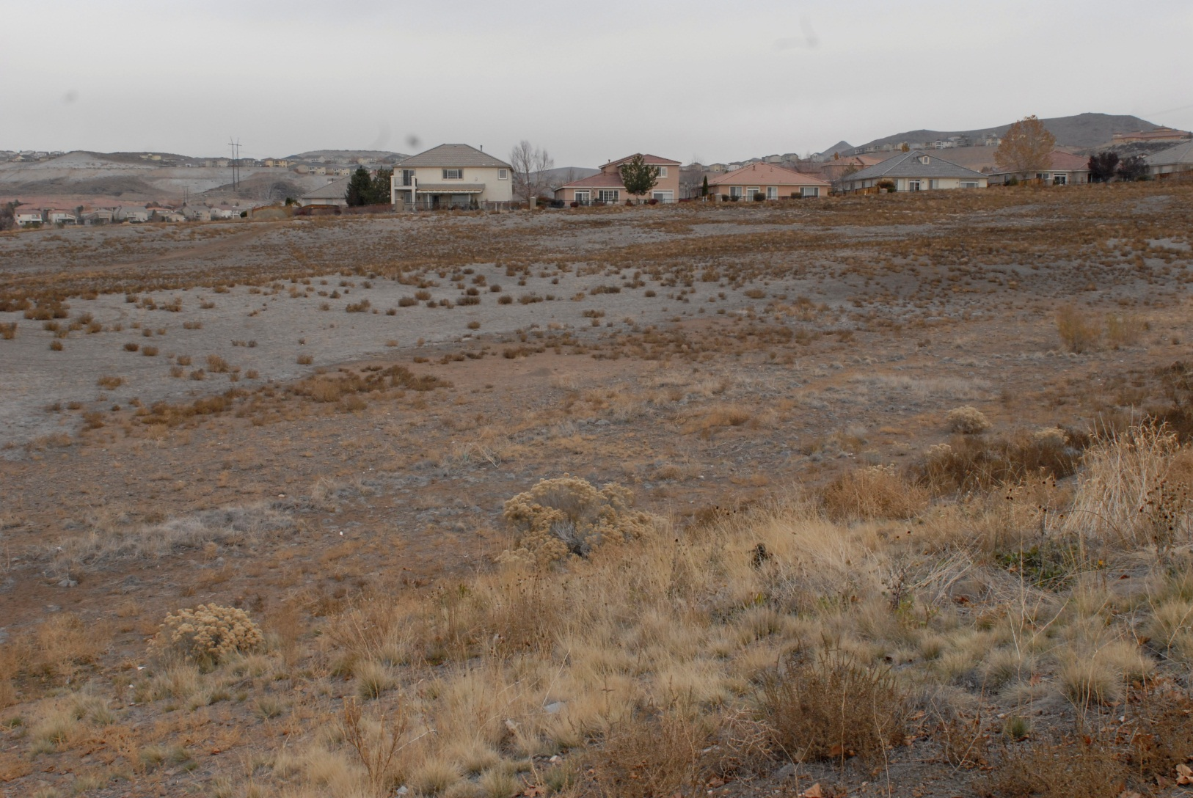
Arrowcreek

Slide 95
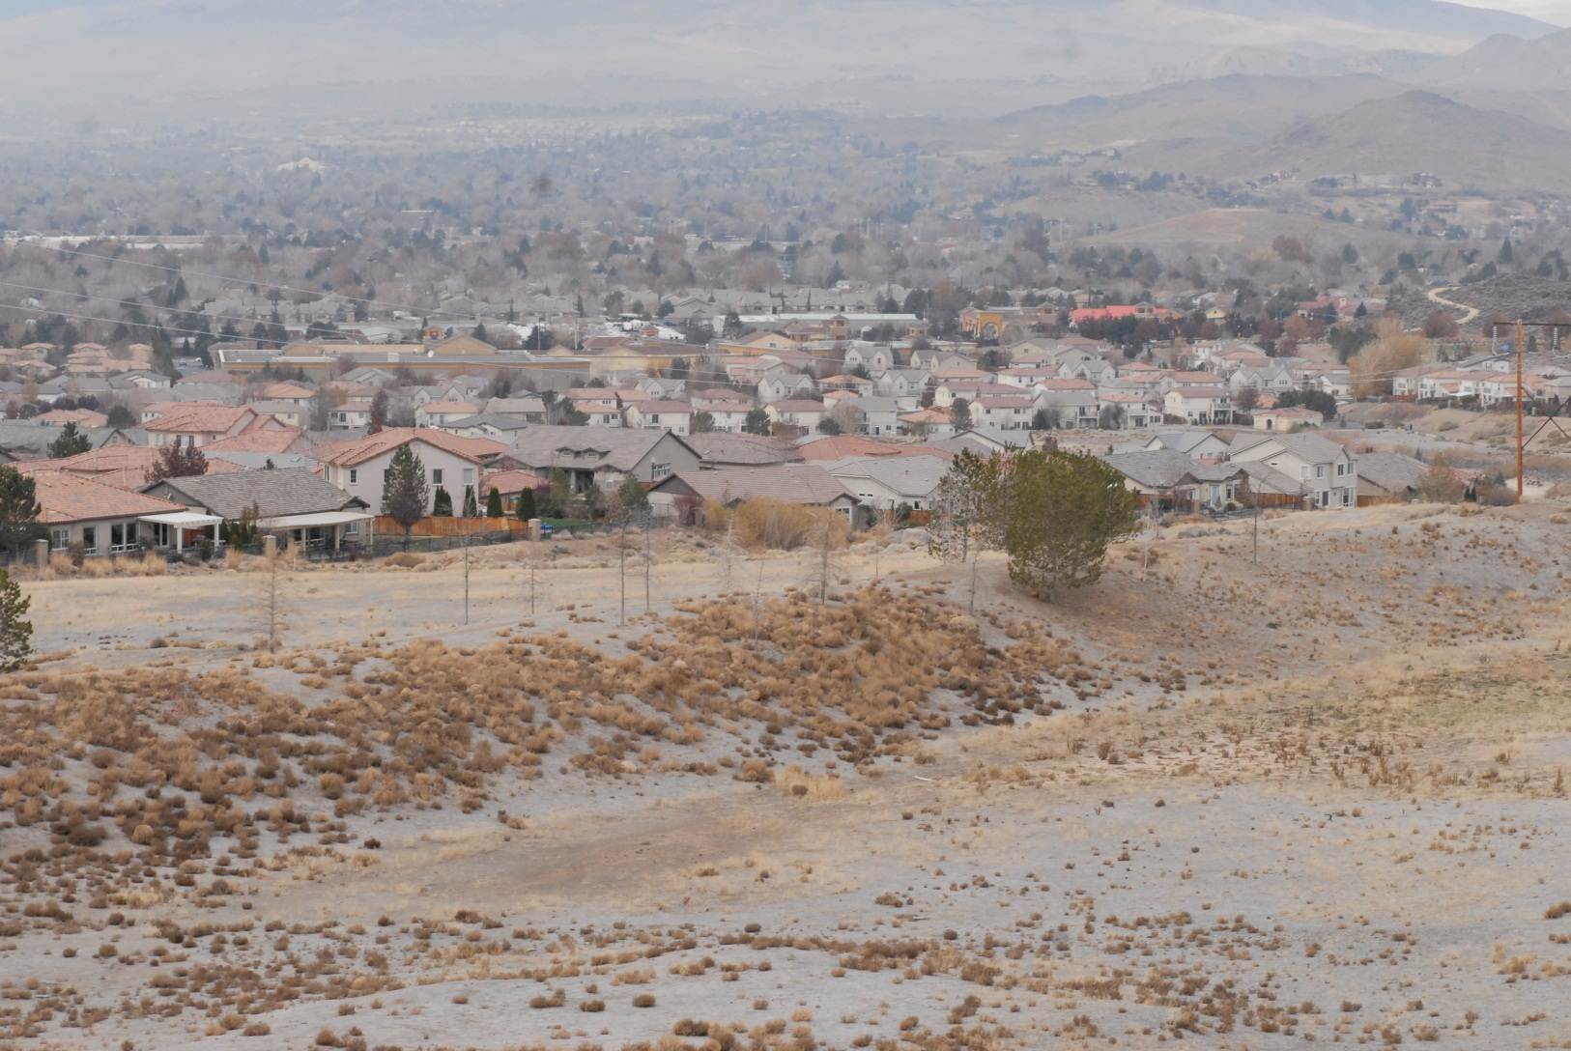
Arrowcreek

Slide 96
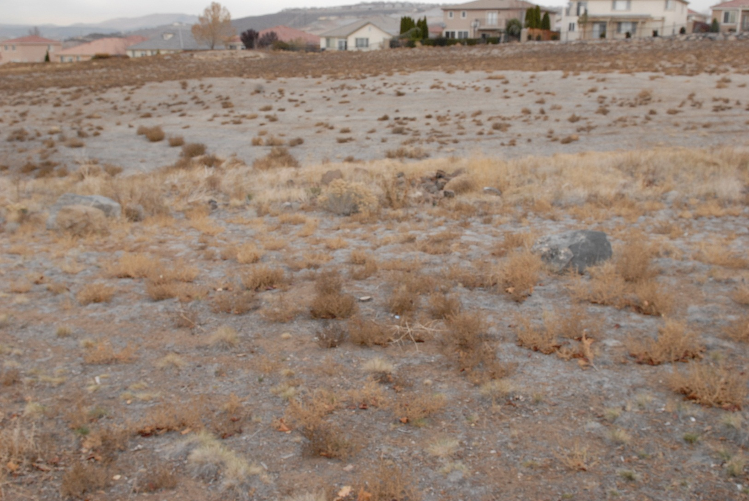
Arrowcreek

Slide 97
D’Andrea versus Arrowcreek
Who looks better?

Slide 98

Home Values-Economy
Apple Computer
Amazon
Telsa Gigafactory
Microsoft
UNR
IGT
Tourism
Gaming industry
Health Care

Slide 99
How to Improve Arrowcreek
Home Values for the long-term
We need to improve the quality of our community landscaping, we have a big problem.
The original subdivision builder went cheap and used rocks for everything including gutters from the entrance to east and west Arrowcreek Parkways and this needs to be fixed.
Notes:
9.

Slide 100
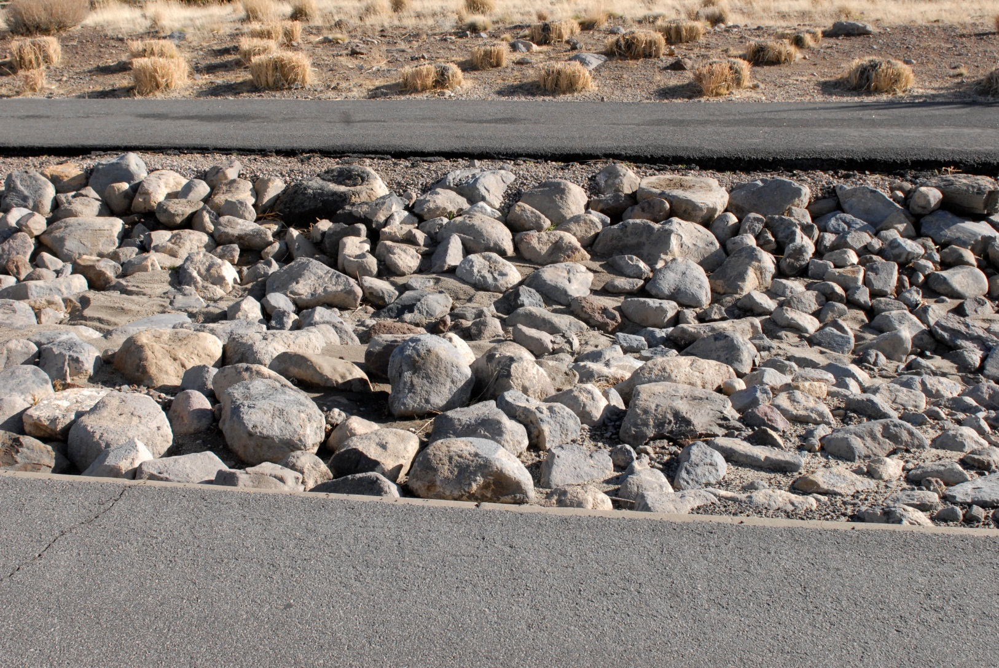
Fixing Arrowcreek

Slide 101
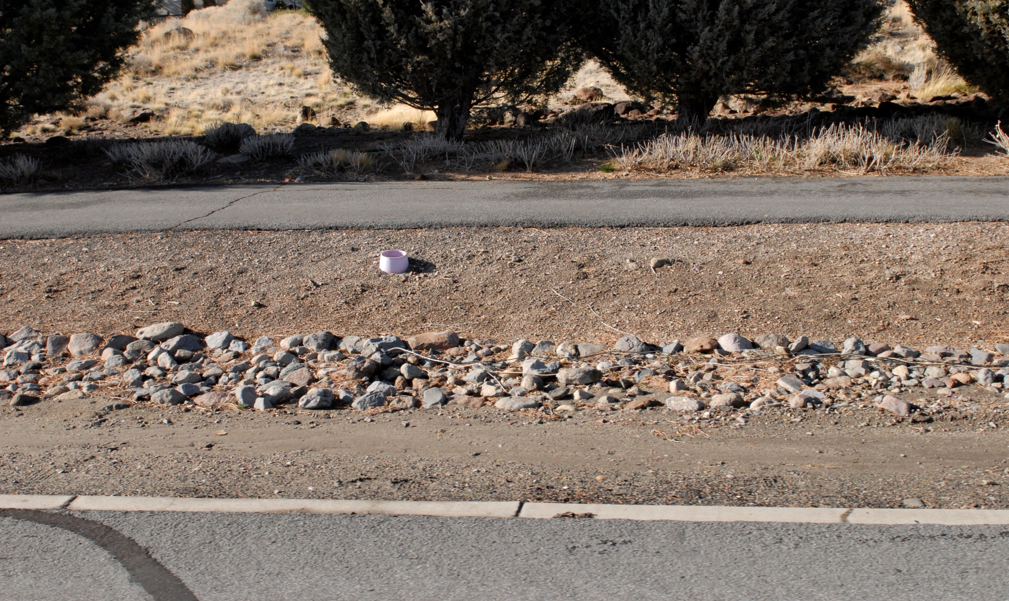
Fixing Arrowcreek

Slide 102
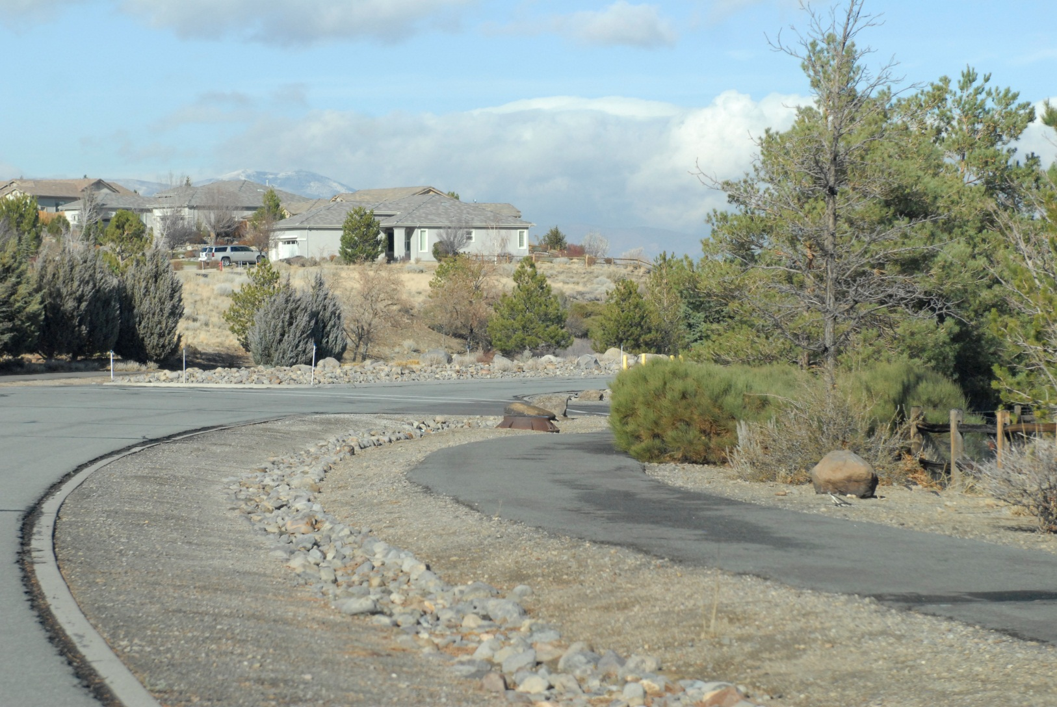
Fixing Arrowcreek

Slide 103
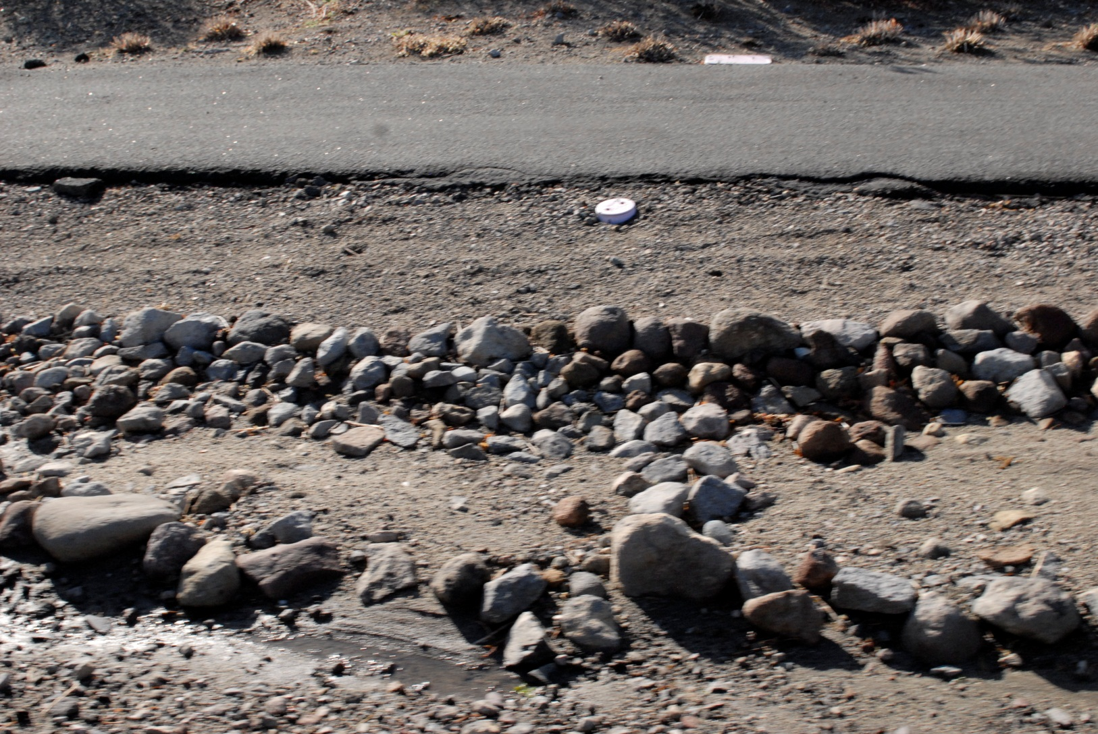
Fixing Arrowcreek

Slide 104
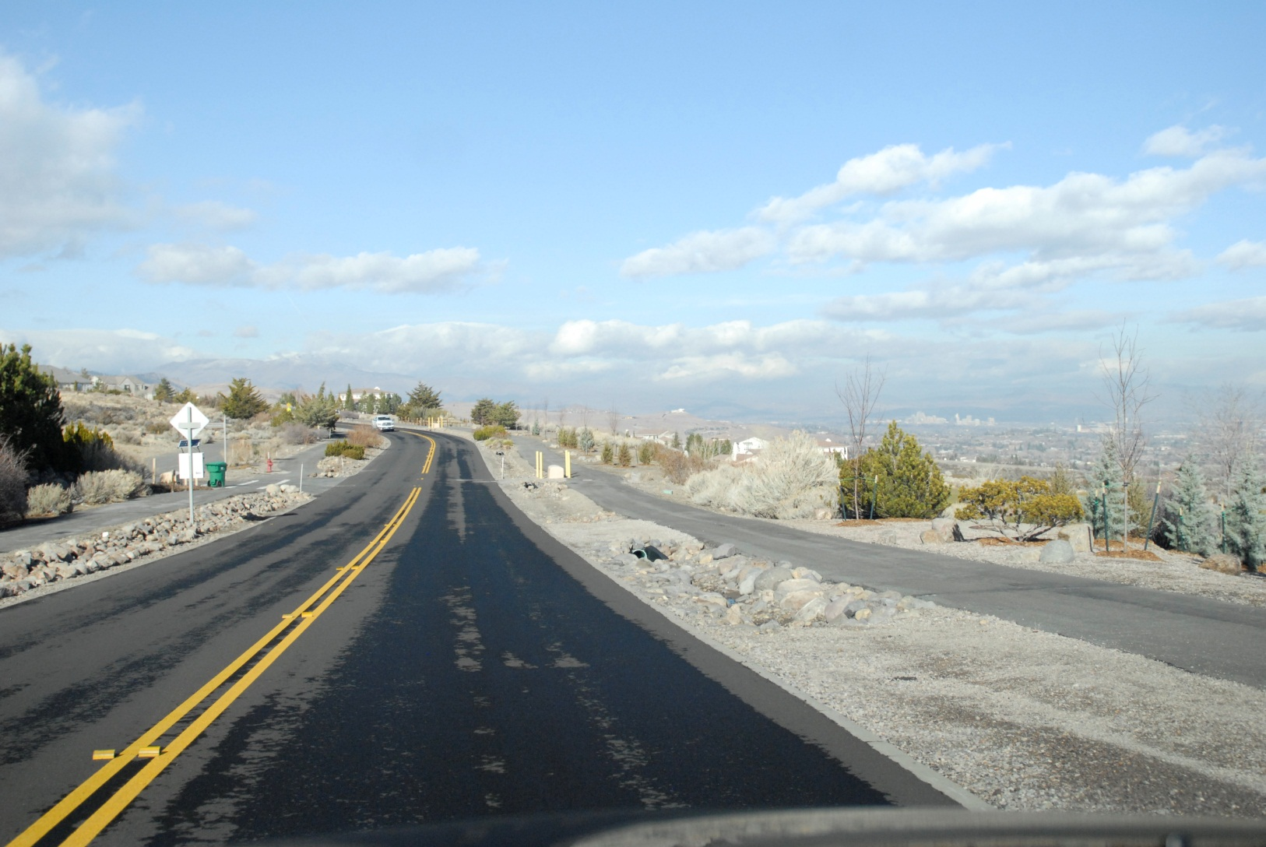
Fixing Arrowcreek

Slide 105
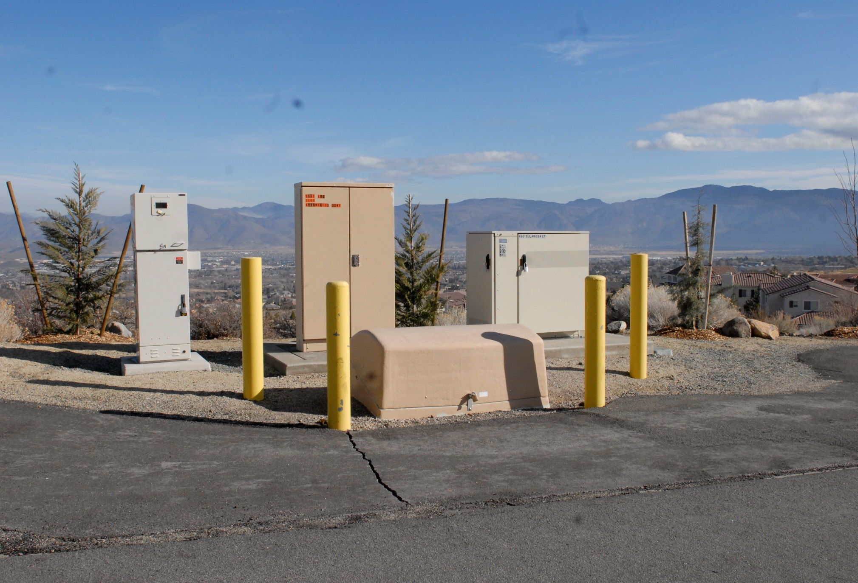
Fixing Arrowcreek

Slide 106
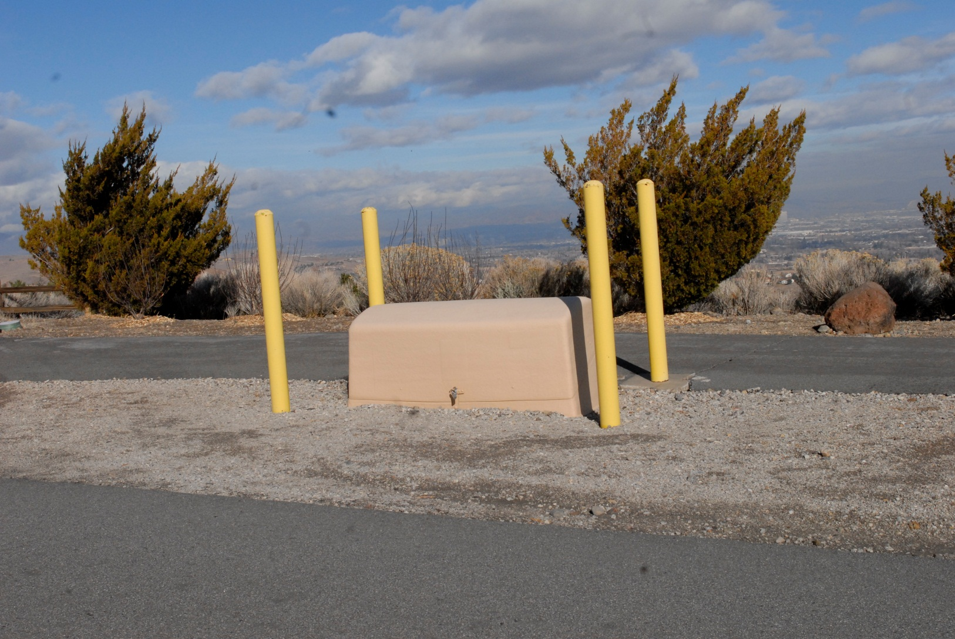
Fixing Arrowcreek

Slide 107
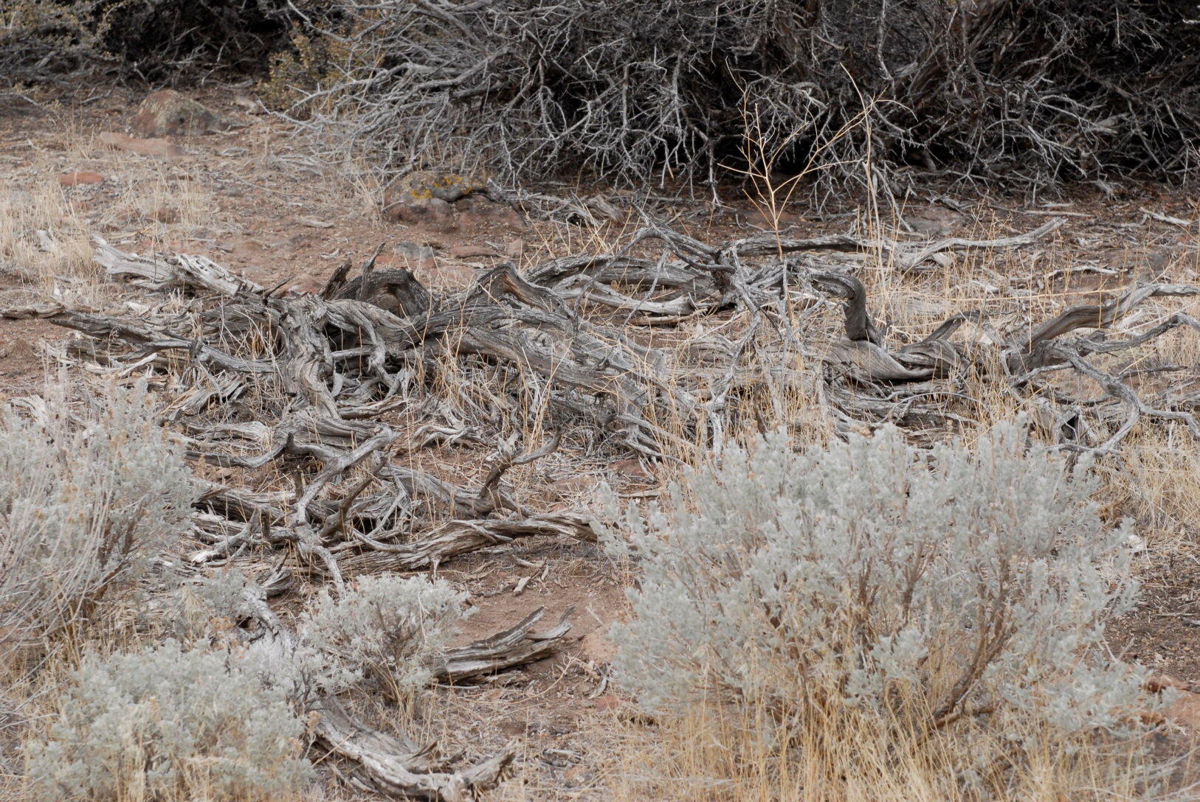
Fixing Arrowcreek

Slide 108
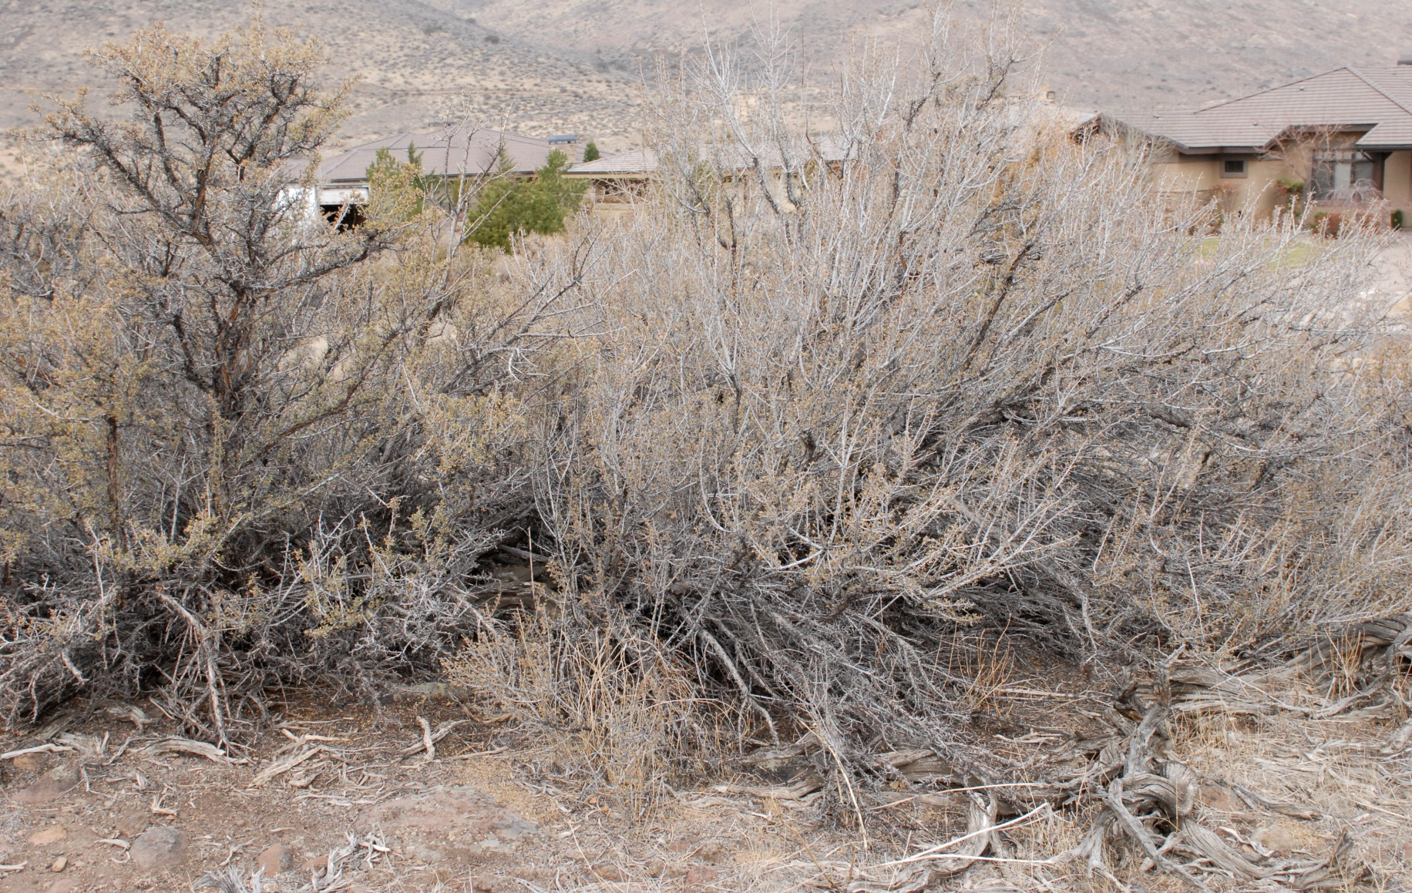
Fixing Arrowcreek

Slide 109
How to Improve Arrowcreek
Home Values for the long-term
Check out High Vista going north and west for a significant difference in beautification. If we want higher home values we have to fix the problem with rocks being used as gutters on Arrowcreek Parkway both east and west because it’s a mess.
We can fix this problem with
focus and our money!
Notes:
9.

Slide 110
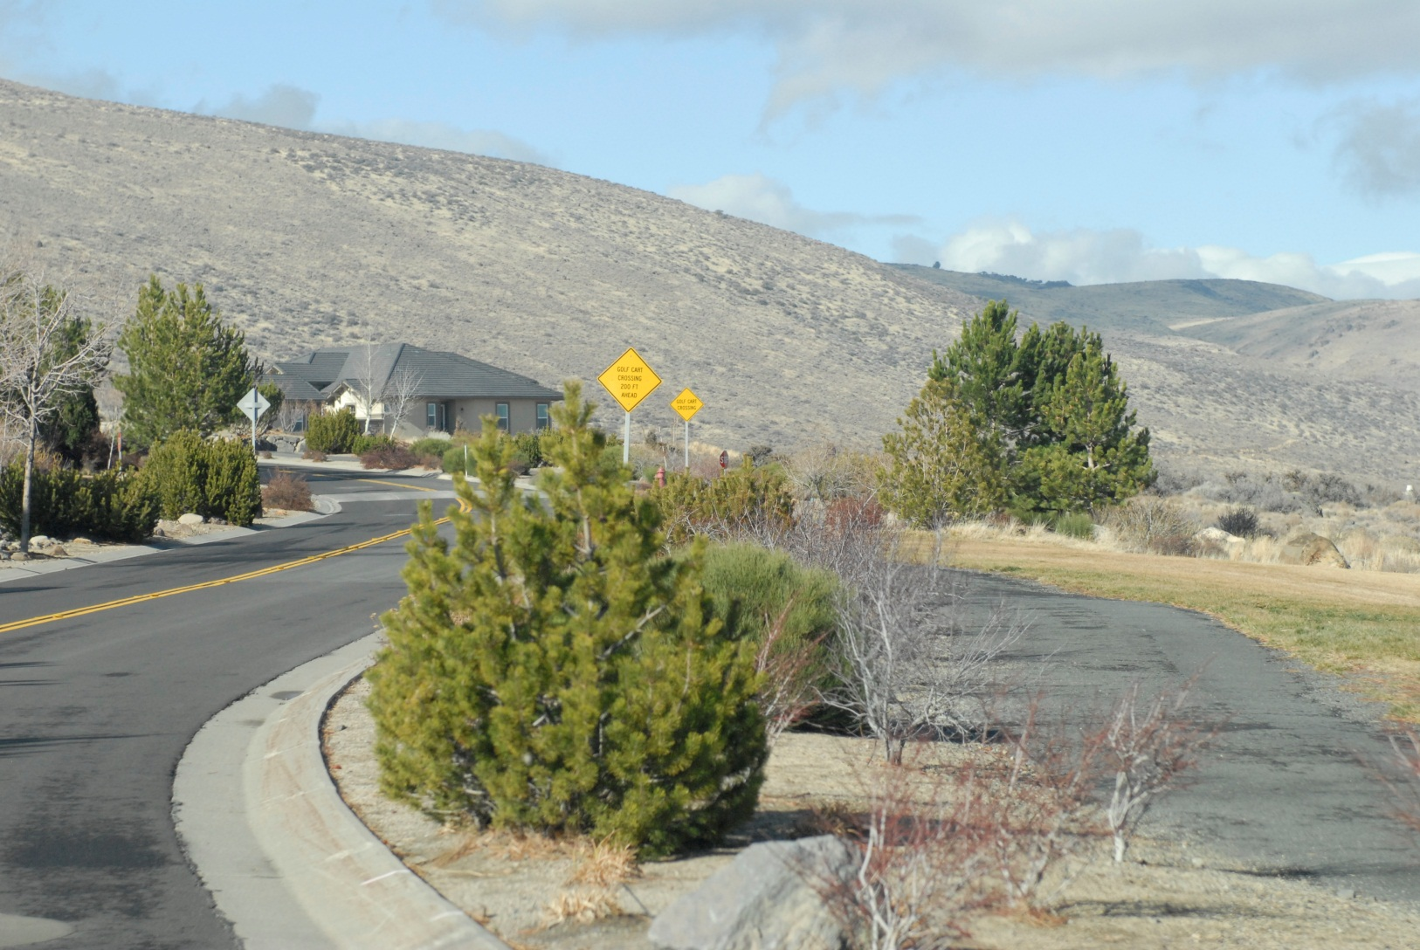
Beautification

Slide 111
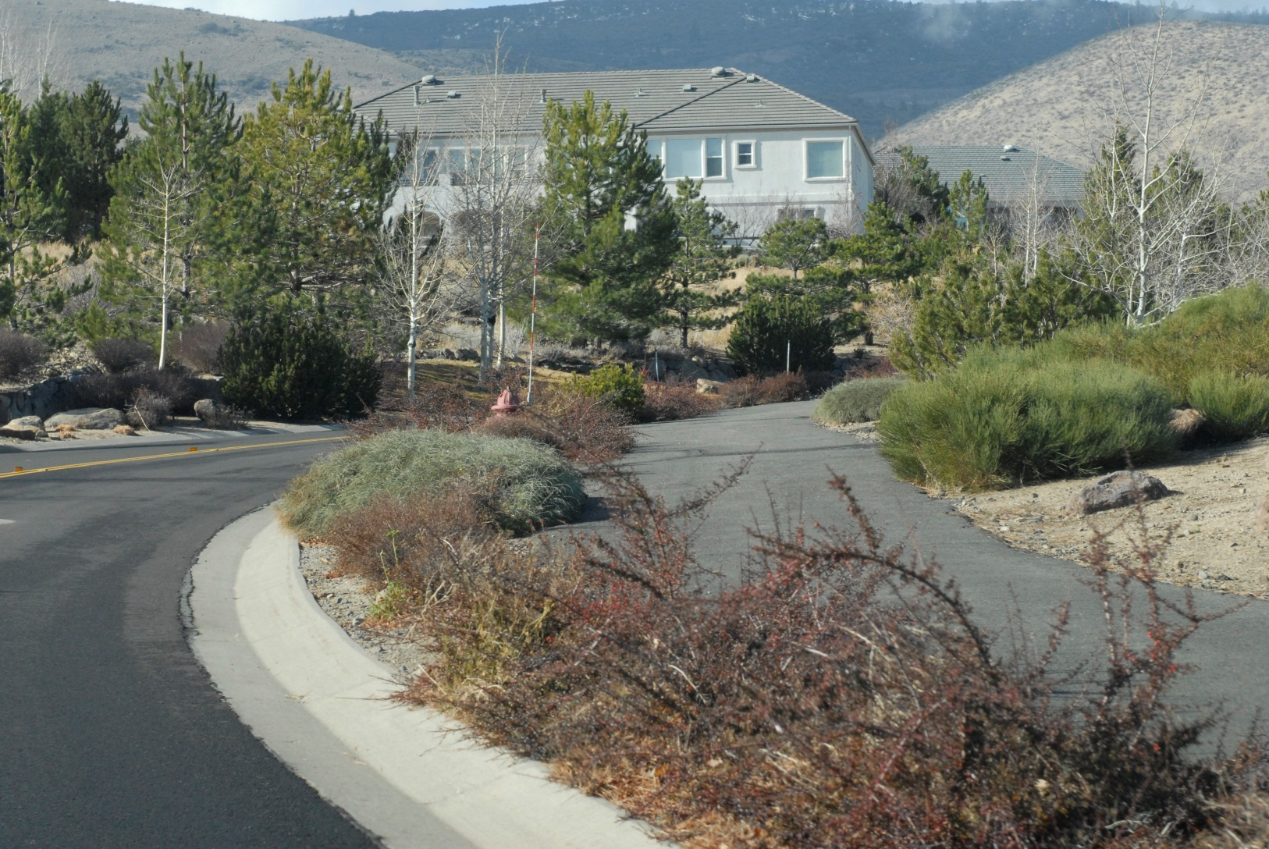
Beautification

Slide 112
We Can Do Better
1. Keep our Not-For-Profit Status
Keep our HOA assets pool, tennis courts and residence center ours
3. Keep Golf independent
Keep our HOA working for the
1,086 lot owners not for
special interests!

Slide 113
We Can Do Better
What can we do as lot owners to raise the home values in Arrowcreek?
  Beautification plan
  Community Events
  Increased communications-Cable TV Channel
  Create a Arrowcreek Improvement Fund
  Finalize a financial budget based on lot owners values and wishes.

Slide 114
We Can Do Better
What is better for the next 10 years?
Ten million dollars in golf course subsidies for a limited number of residences and non-residences?
Or
Using the Ten million dollar to invest in our community where all 1,086 lot owners received the benefit not just a few special interest individuals?

Slide 115
We Can Do Better
Arrowcreek offers lot owners the following:
1. Unlimited community activities
2. Let’s use lot owner money to build Arrowcreek into a destination community
3. We could offer any of the following:

Slide 116
We Can Do Better
We could offer any of the following:
Beautification Plan
Films in the Park
Pickle Ball courts
Dog Parks
Lawn Bowling
Bocce Ball Courts

Slide 117
We Can Do Better
We could offer any of the following:
7. Lights for the Tennis courts
8. Kids Parks
9. Fishing Pond
10. Bike Course
11. Dome for the swimming pool
12. Soft ball field
Notes:
9.

Slide 118
We Can Do Better
We could offer any of the following:
13. Sledding hill
14. Shuffle Board courts
15. Parks like Harbottle
16. Volleyball courts
17. Bird watching area
18. Community Vegetable Garden
Notes:
9.

Slide 119
We Can Do Better
We could offer any of the following:
19. Horseshoe pits
20. Racquet Ball Court
21. Ping Pong Table
22. Pool Table
23. Massages
24. Pilates
Notes:
9.

Slide 120
We Can Do Better
We could offer any of the following:
25. Frisbee Golf
26. Dome for One Tennis Court
27. Miniature Golf Course
28. Walking Trails
29. Game Room (Cards & Games)
30. Larger Work Out Room
Notes:
9.

Slide 121

Beautification Plan

Slide 122
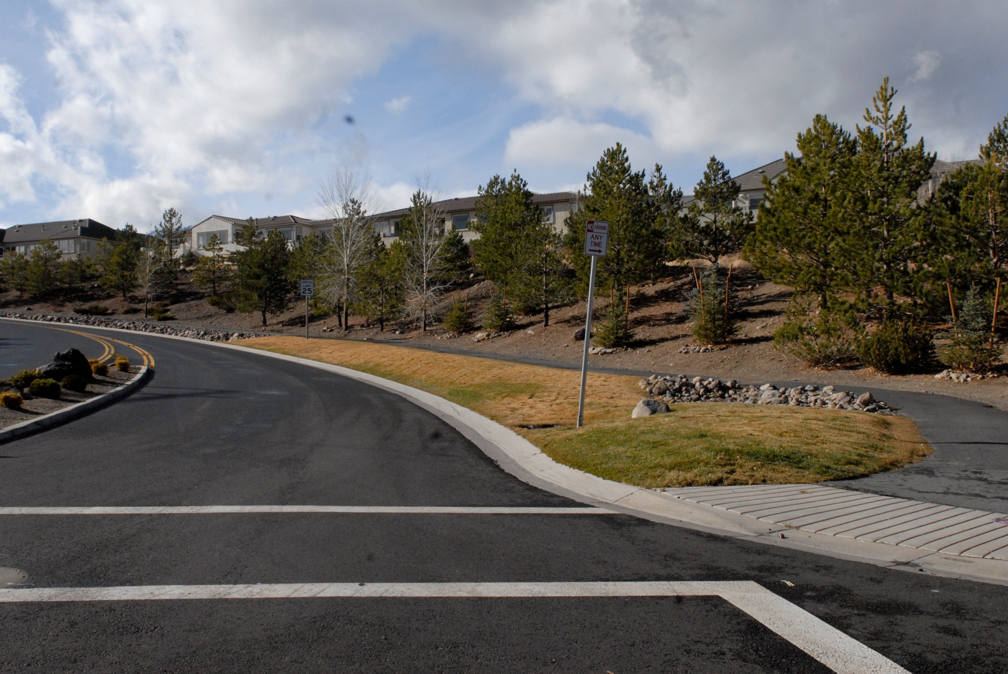
Beautification

Slide 123
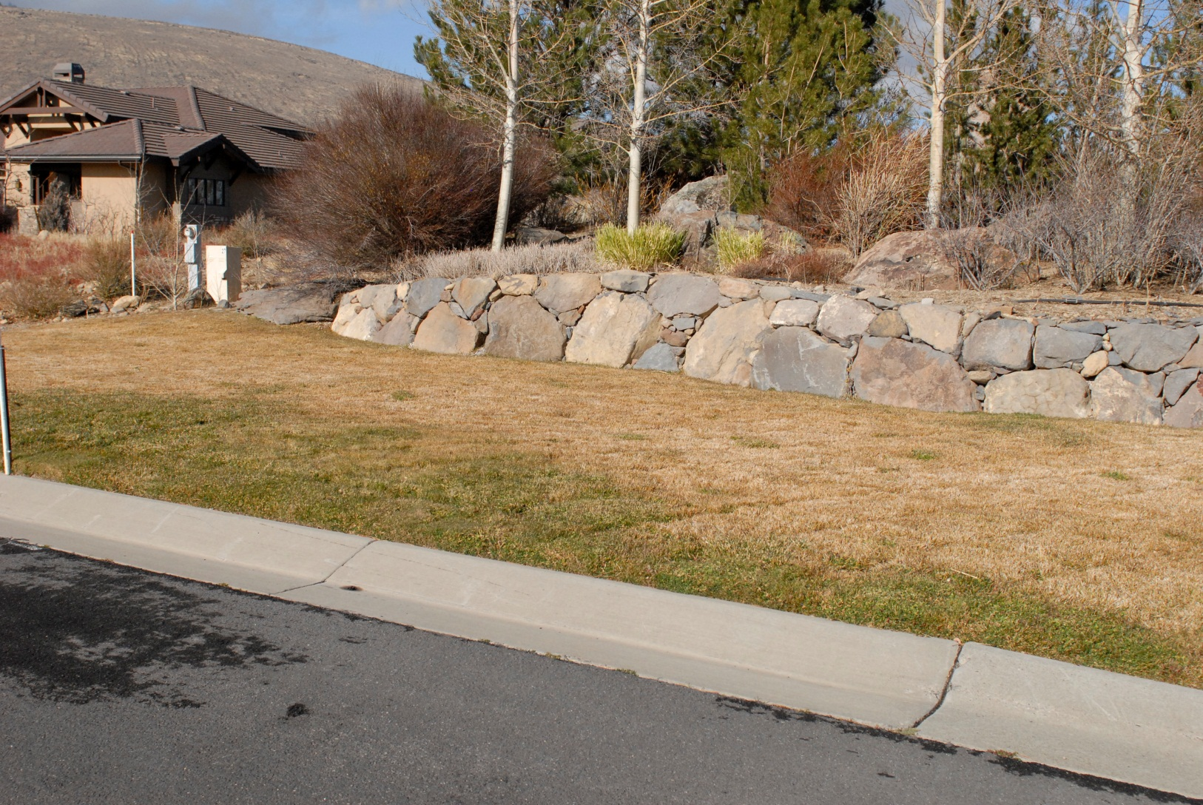
Beautification

Slide 124

Films in the Park

Slide 125

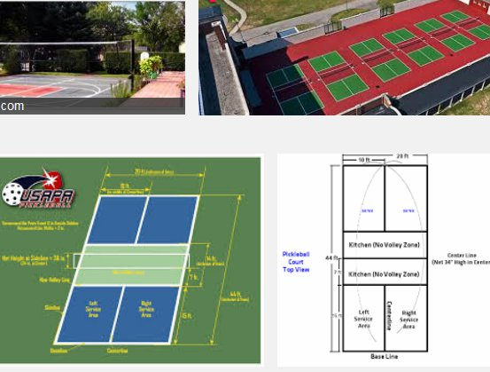
Pickle Ball Courts

Slide 126

Dog Parks

Slide 127
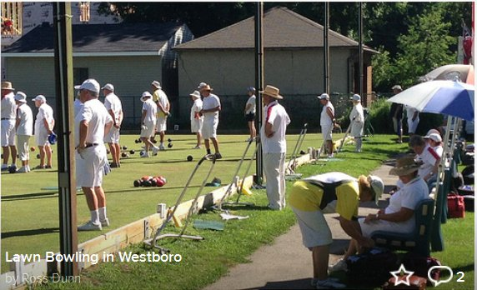
Lawn Bowling

Slide 128

Lawn Bowling

Slide 129
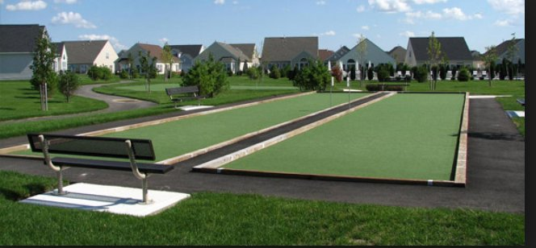
Bocce Ball Courts

Slide 130
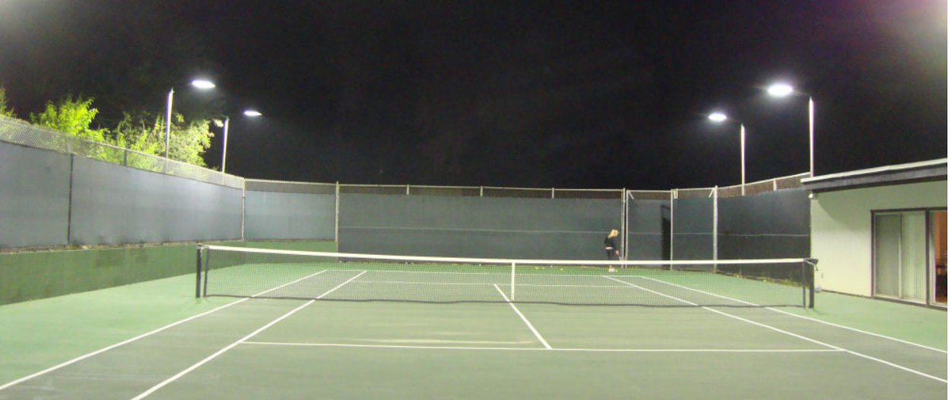
Lights for the Tennis Courts

Slide 131
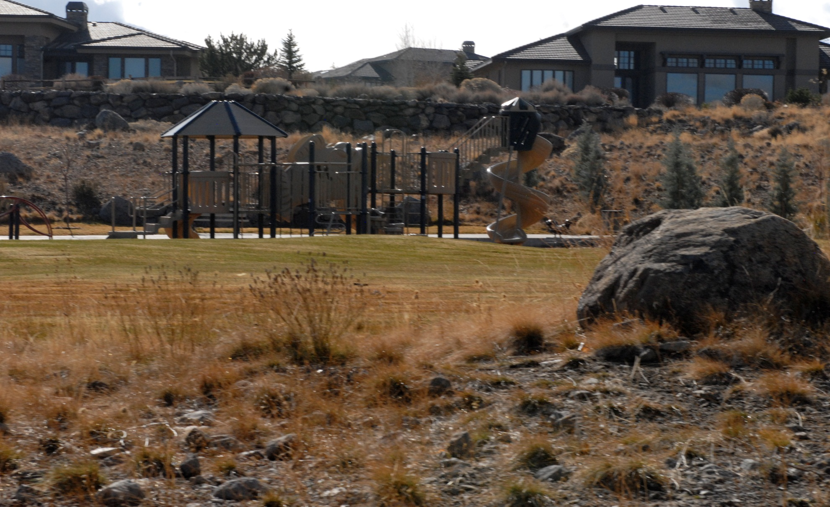
Kids Parks

Slide 132

Fishing Pond

Slide 133

Bike Course

Slide 134
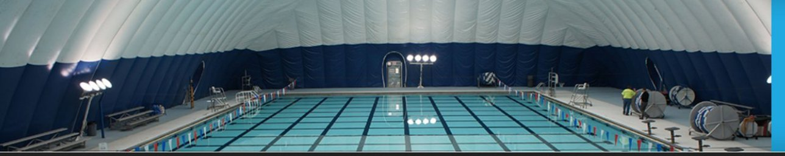
Dome for the Swimming Pool

Slide 135

Softball Field

Slide 136

Sledding Hill

Slide 137
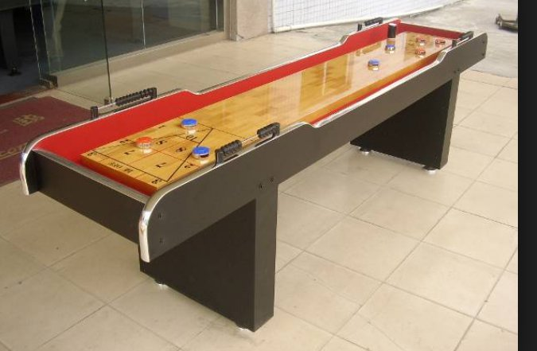
Shuffle Board

Slide 138

Parks like Harbottle

Slide 139
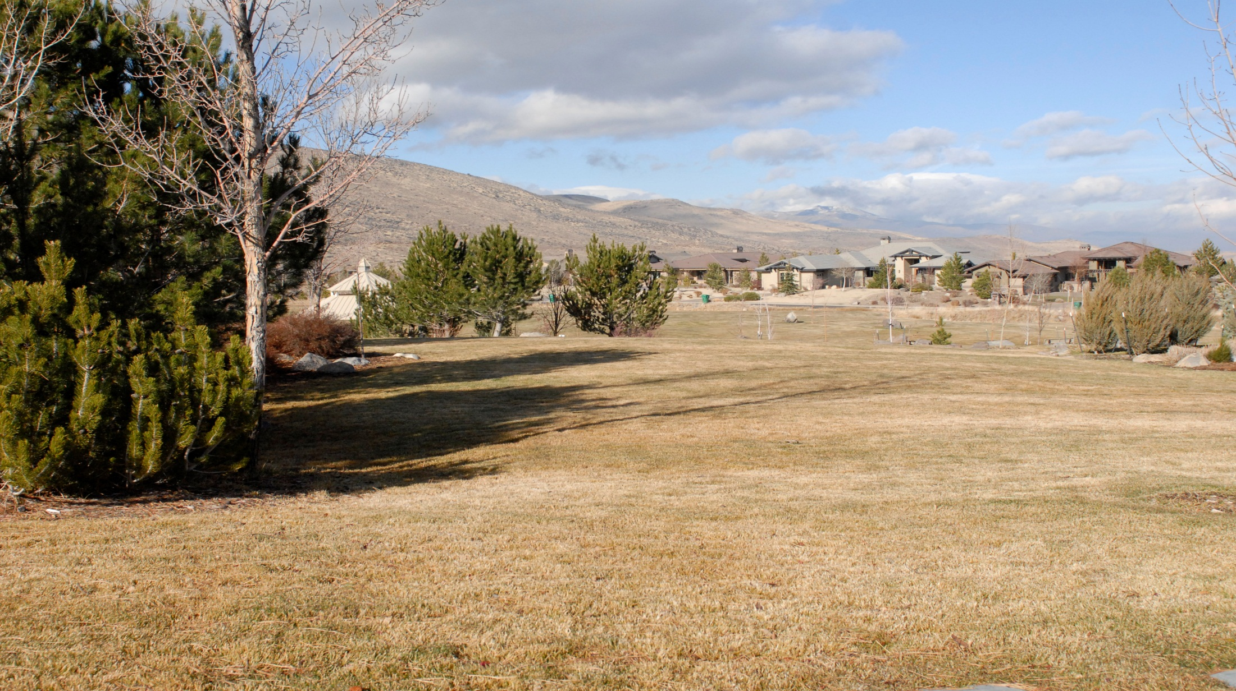
Parks like Harbottle

Slide 140

Volleyball Courts

Slide 141

Bird Watching Area

Slide 142
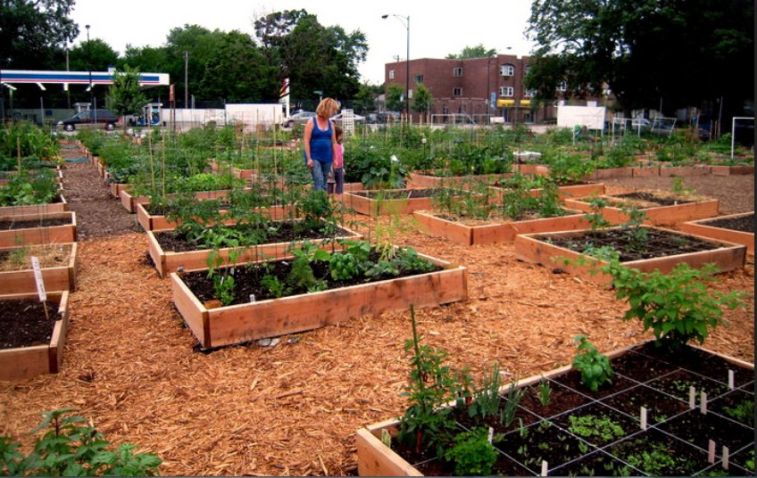
Community Vegetable Garden

Slide 143
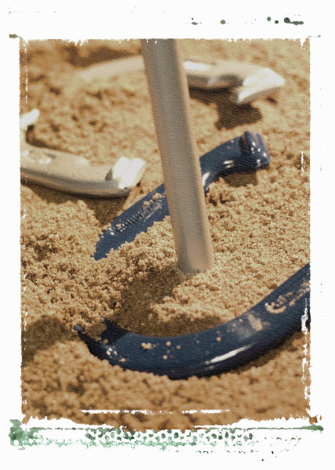
Horseshoe Pits

Slide 144

Racquet Ball Courts

Slide 145

Ping Pong Tables

Slide 146

Pool Tables

Slide 147

Massages

Slide 148

Pilates

Slide 149

Frisbee Golf

Slide 150
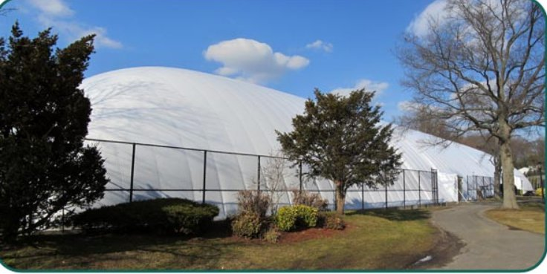
Dome for One Tennis Court

Slide 151

Miniature Golf Course

Slide 152

Walking Trails

Slide 153

Game Room

Slide 154

Larger Work-Out Room

Slide 155
Arrowcreek
Improvement
Fund

Slide 156
Arrowcreek Improvement Fund
We need a new ballot measure that allows the lot owners to vote on a plan for an all
Arrowcreek Improvement Fund.
The measure would read: Vote Yes for a budget dedicated 100% to making improvements in Arrowcreek . Your authorization is for: $25.00, $50.00, $75.00, $100.00 per month.
All projects are voted on by lot owners.
Notes:
9.

Slide 157
Arrowcreek Improvement Fund
$25.00/month per lot equals $325,800
$50.00/month per lot equals $651,600
$75.00/month per lot equals $977,400
$100.00/month per lot equals $1,303,200

Slide 158
OPTIONS

Slide 159
What are our options?
OPTION A.
Vote yes for the HOA buying the golf club from FOA. Pay for all upgrades and expenses and a monthly subsidy of $100.00 per month or $1,303,200 annually, up to $150.00 per month or $1,954,800 annually.

Slide 160
What are our options?
OPTION B.
Vote NO for the HOA buying the golf course from the FOA.
No change in monthly dues.

Slide 161
What are our options?
OPTION C.
Vote Yes, for the Arrowcreek Improvement Fund, where 100% of funds are directly put to work for the overall improvement of Arrowcreek.

Slide 162
Arrowcreek Improvement Fund
Option C
$25.00/month per lot equals $325,800
$50.00/month per lot equals $651,600
$75.00/month per lot equals $977,400
$100.00/month per lot equals $1,303,200

Slide 163
Cost Summary of Options
A. B. C.
ANNUAL DUES $ 2,616.00 $2,616.00 $2,616.00
GOLF SUBSIDY $100.00=$1,200.00 0 0
$125.00=$1,500.00
$150.00=$1,800.00
$175.00=$2,100.00
ARROWCREEK $25.00=$300.00
IMPROVEMENT $50.00=$600.00
FUND 0 0 $75.00=$900.00
$100.00=$1,200.00
TOTALS $100= $3,816.00 $25= $2,916.00
ANNUAL $125= $4,116.00 $50= $3,216.00
COST $150= $4,416.00 $2,616.00 $75= $3,516.00
$175= $4,726.00 $100= $3,816.00

Slide 164
Please Remember,
We have Options!

Slide 165
Please Remember,
We can do better!

Slide 167
Friends of Arrowcreek
The Friends of Arrowcreek made a business decision driven by selling the club to the HOA for a profit and they want the 1,086 home/lot owners to believe this is the only option, but we need a million dollar a year subsidy!
We can do better!

Slide 168
What actions should we the 1,086 lot owners take?

Slide 169
Are you ready to make a multi-million dollar decision that will potentially last for years?

Slide 170
Friends of Arrowcreek
December 9, APG Meeting Outcomes
FOA has no desire to run/operate a golf course, only retrieve their collective investment (at a profit).
2. APG wants to have a Community Club
environment that they can use as part
of the golfing enterprise with no
experience in this field.

Slide 171
We Can Do
Better!

Slide 172
How can we improve real estate values for the 1,086 lot owners in Arrowcreek ?

Slide 173
1,086 Lot Owners in Arrowcreek
We have options. Let’s explore some non-biased, open minded, concepts for a better Arrowcreek.
We can do better!

Slide 174

Keep an open mind.
We can do better!

Slide 175
Agenda
1. The role of the HOA
2. Friends of Arrowcreek
3. We Can Do Better!
4. Creation of the Arrowcreek Improvement Fund
5. Options and Cost Estimates

Slide 176
Arrowcreek HOA Web-site
Homeowners Association ArrowCreek provides community leadership, architectural control, covenant enforcement, community events, accounting and finance, operation and maintenance of recreation facilities.

Slide 177
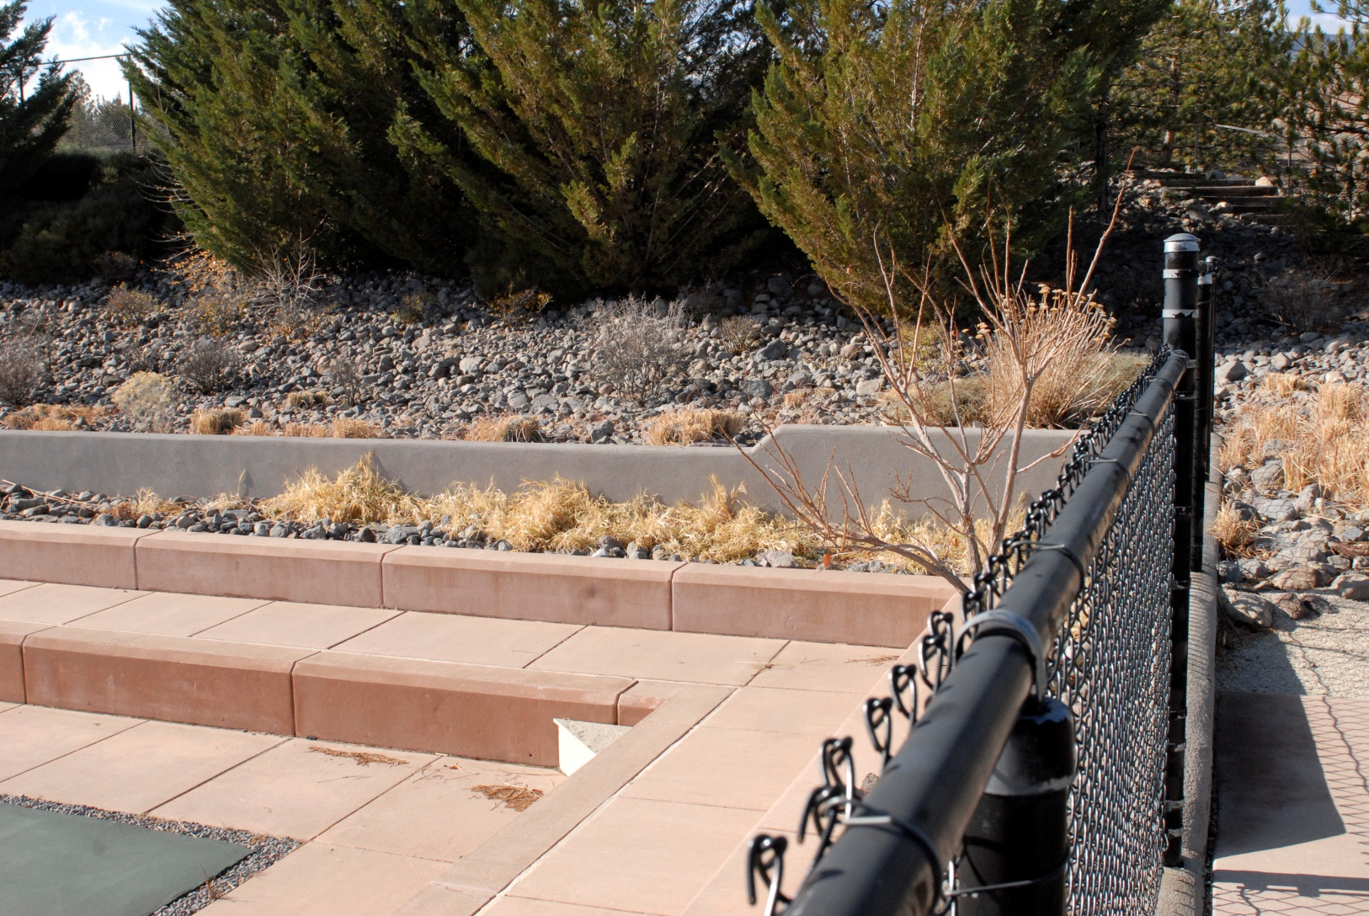
HOA RESPONSIBILITIES

Slide 178
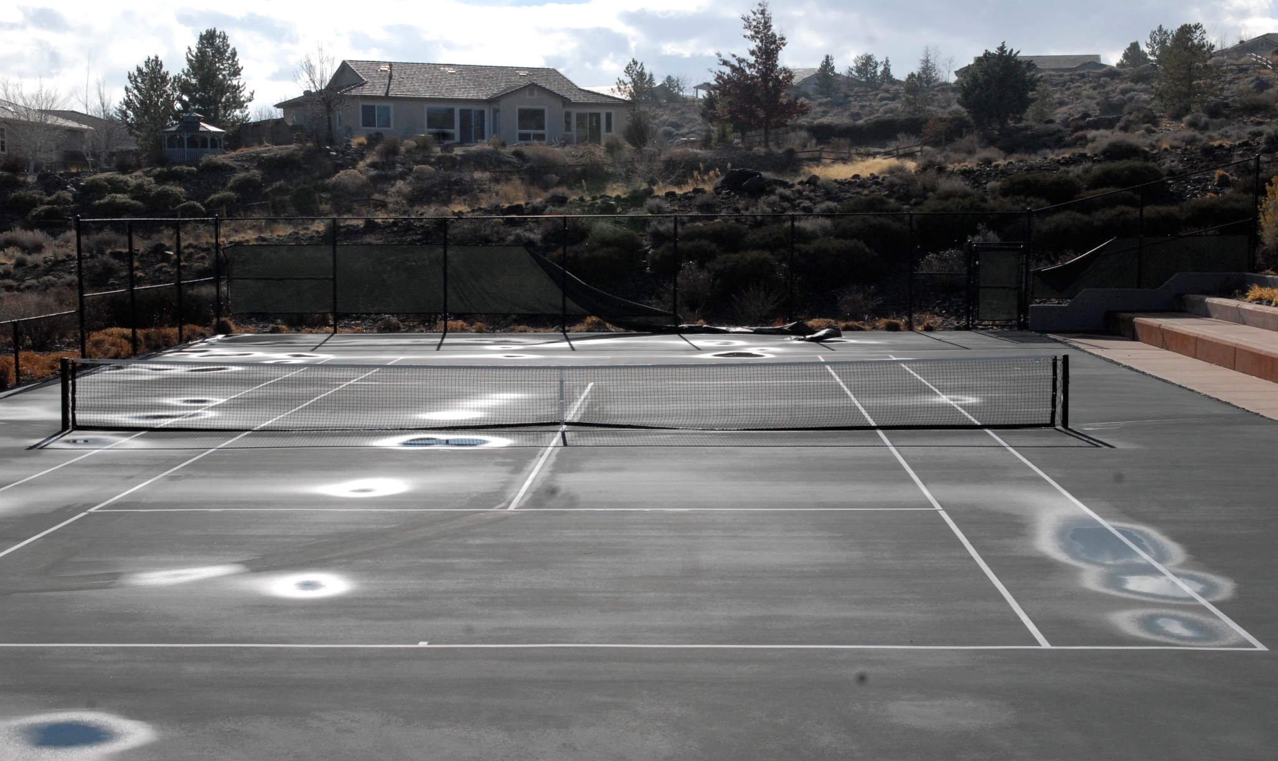
HOA RESPONSIBILITIES

Slide 179
Arrowcreek HOA Web-site
Homeowners Association Community Events, 1. Annual Holiday Party in December 2. Easter Egg Hunt for Kids 3. Halloween Party for Kids 4. 5. 6.

Slide 180

2014 HOA Holiday Party

Slide 181
Arrowcreek HOA Web-site
Homeowners Association Community leadership is provided by the Board of Directors, as well as the Association Committees. All residents can participate in various committees.

Slide 182

HOA RESPONSIBILITIES

Slide 183

HOA RESPONSIBILITIES

Slide 184
HOA Focus
Keep Golf independent!
Keep our HOA Board working for all 1,086 lot owners not for the interests of a special few!

Slide 185
What Options Do We Have?
Vote No on the measure and give no subsidy to the FOA.
All lot owners back away from any ownership of the club.

Slide 186
Option 4.
Still another home owner recommended that we just wait for two or three years and see if the FOA, can build the club back to profitability.

Slide 187
HOA Board Fiduciary
Responsibilities
Keep working for the betterment of the 1,086 lot owners.

Slide 188
Options for ArrowCreek Residents
On October 15, 2014, FOA purchased the golf courses and hired Arnold Palmer Professional Golf as manager.
At the next Board meeting on November 4, 2014, a new power point presentation was made and the “Do Nothing”, option was never mentioned.
The FOA owned the course and was responsible for liabilities tied to ownership.

Slide 189
Options for ArrowCreek Residents
We would have no reason to have a Joint Venture with Arnold Palmer Golf which would require us to relinquish the Residents Club and raise homeowners fees $100 per month, paying the Joint Venture over a million dollars a year as a subsidy.

Slide 190
Options for ArrowCreek Residents
Based on these representations and failures to disclose all the facts, it appears that the Board of Directors failed to recognize their fiduciary duties to the homeowners.

Slide 191
Options for ArrowCreek Residents
Obviously, months before its August 26th presentation, the Board has decided that purchasing the courses from the FOA and then form a joint venture with Arnold Palmer Golf was the only way to proceed.

Slide 192
Options for ArrowCreek Residents
According to Nevada law, the Board members and their officers are fiduciaries and must act on an informed basis, in good faith, and in the honest belief that their actions are in the best interest of the homeowners.
They are prohibited from acting outside the scope of the governing documents, and may not commit an act or omission that amounts to negligence, and are supposed to represent all members and not just a select few.

Slide 193
Options for ArrowCreek Residents
The Nevada Revised Statues 116.3103 provides that homeowner association officers and directors are fiduciaries.
Are required to exercise the ordinary and reasonable care officers and directors of a nonprofit corporation subject to the business judgment rule;
Are subject to conflict of interest rules governing the officers and directors of a nonprofit corporation organized under the law of this State.

Slide 194
Options for ArrowCreek Residents
In addition, the Nevada courts have recognized that the fiduciary has a duty of loyalty which requires the board and its shareholders to maintain, in good faith, the corporation’s and its shareholders’ best interest over anyone else’s interest.
A violation will only be found where there is either intentional misconduct, fraud, or a knowing violation of the law. When the fiduciary’s interestedness is challenged, the burden is on the fiduciary to show the transaction’s entire fairness to the corporation.
Source: Shoen v. SAC Holding Corp., 137 P.3d (Nev. 1971)

Slide 195
ArrowCreek HOA Web-site
The HOA Association is a not-for-profit organization of owners formed for the purpose of maintaining the common areas.

Slide 196
HOA Focus
A burden will potentially be placed on the Resident’s Center, Tennis Courts, and Pools by people
who are not ArrowCreek residents.

